Slide 1
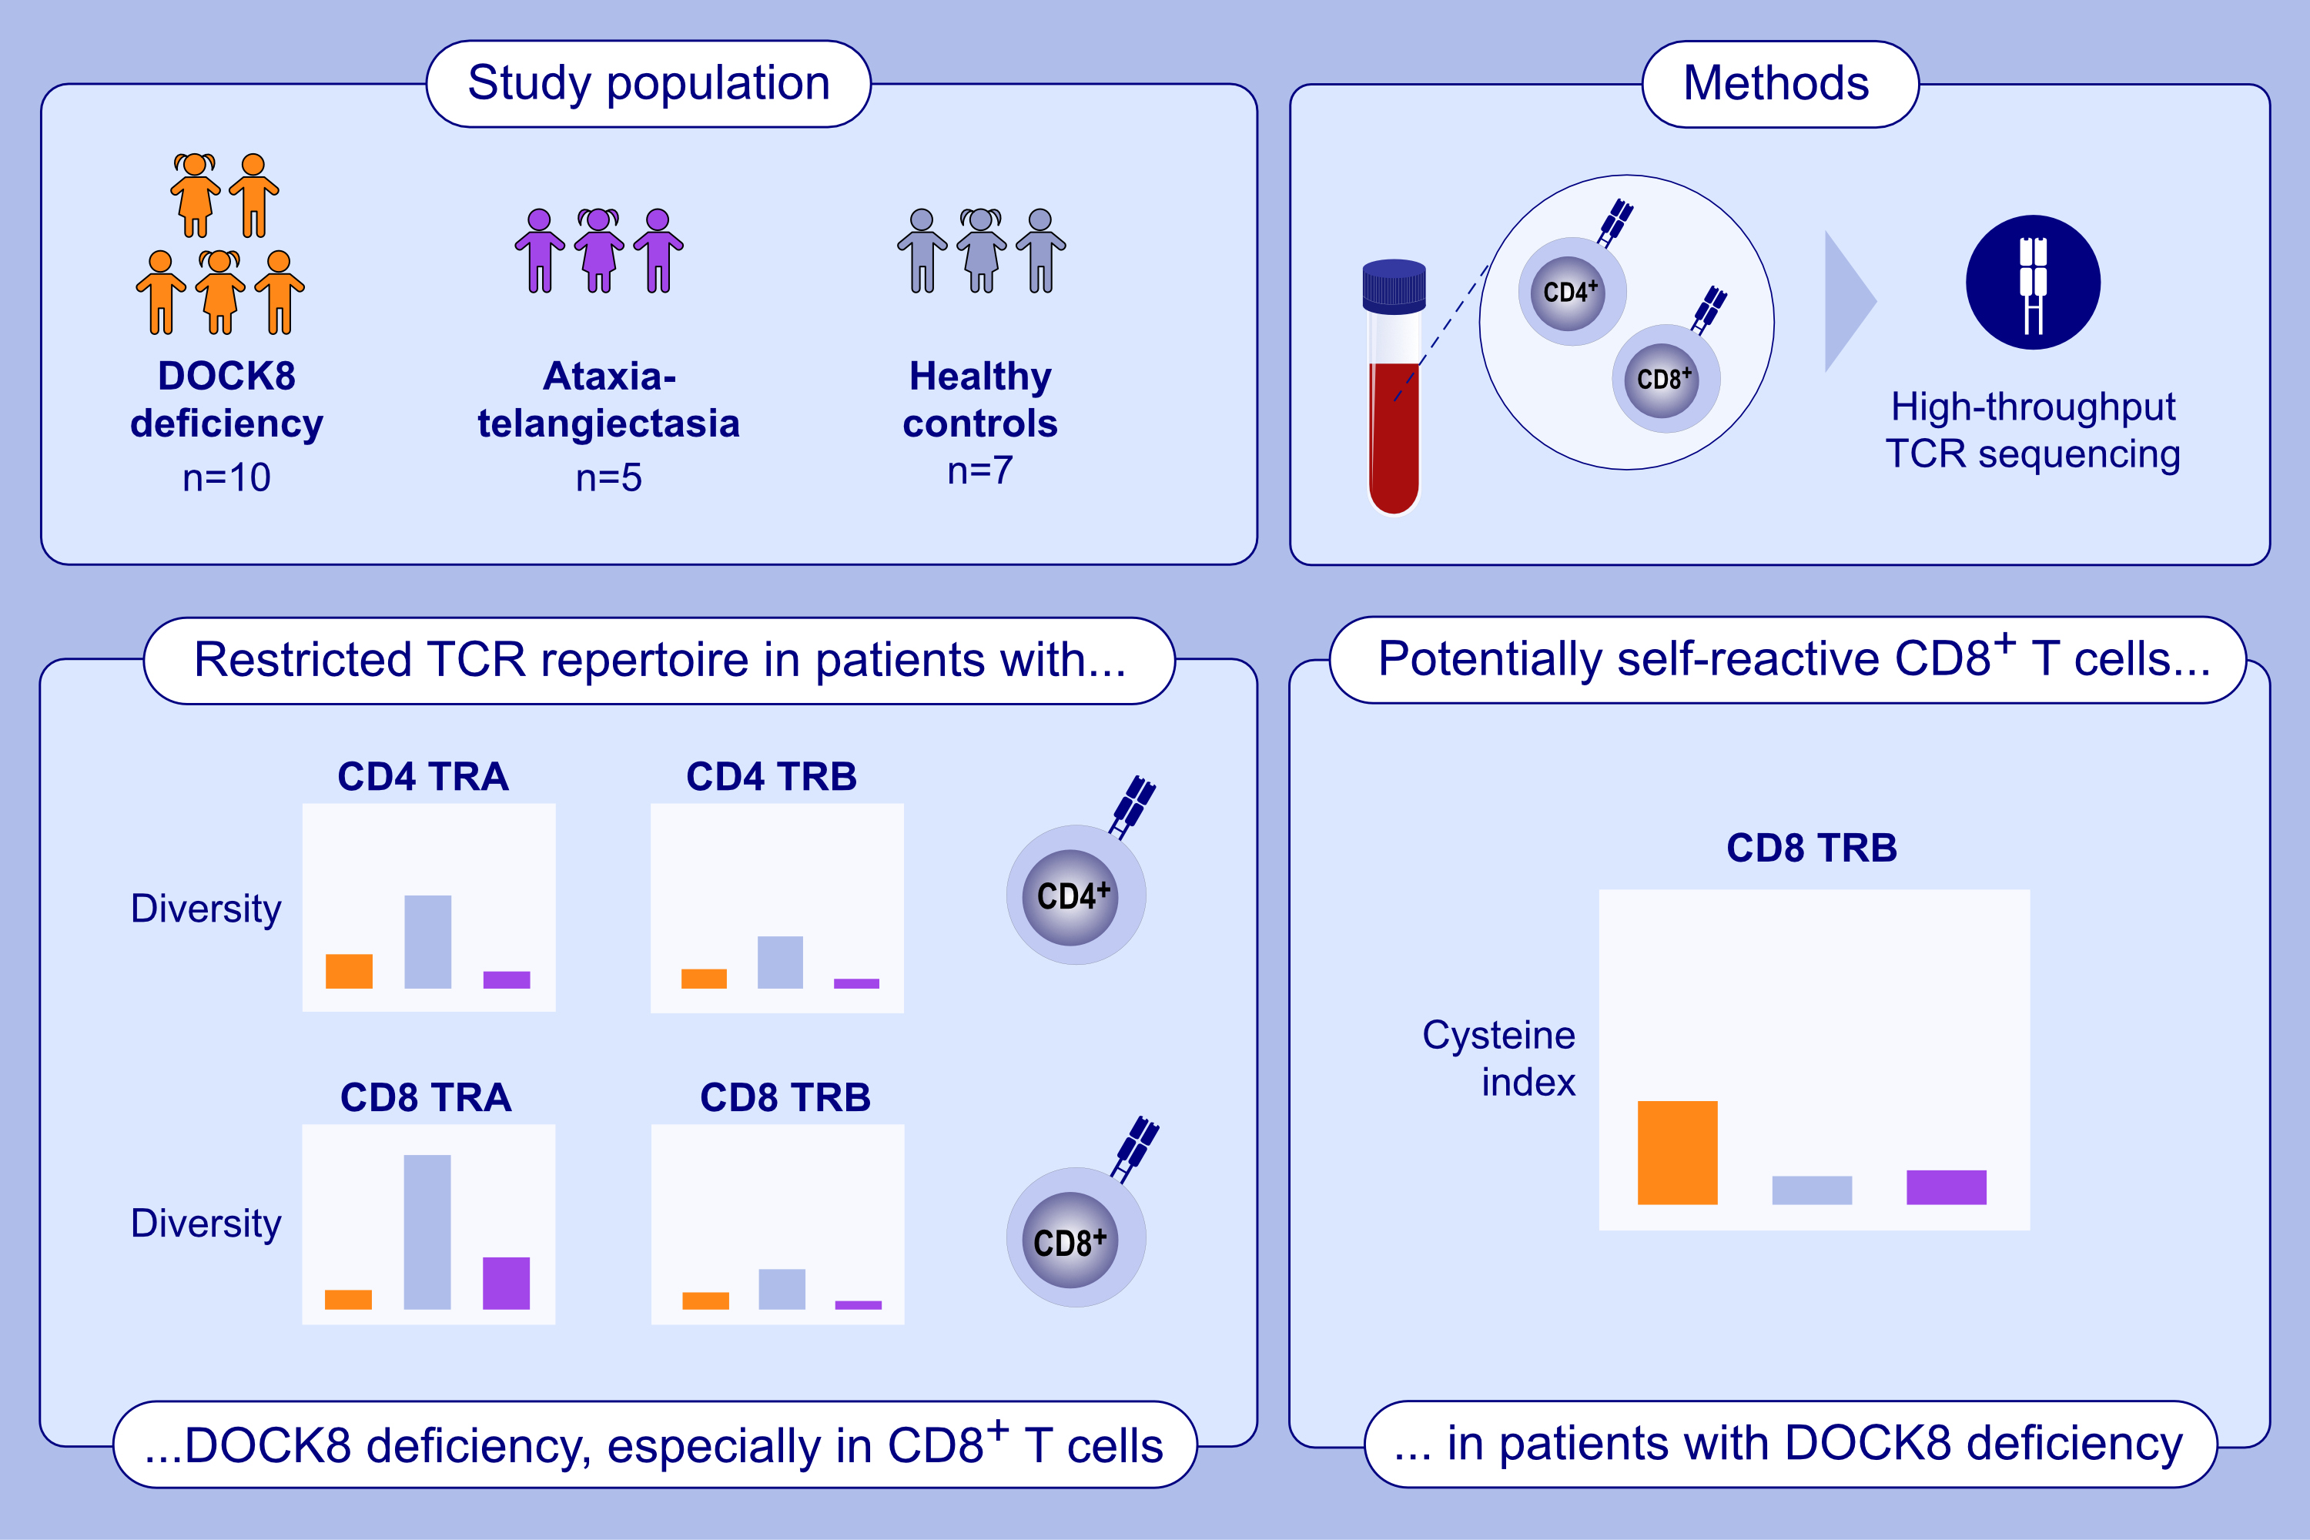
Comprehensive αβ T-Cell Receptor Repertoire Analysis Reveals a Unique CD8+ TCR Landscape in DOCK8-Deficient Patients
Ceren Bozkurt, Gökhan Cildir, Umran Aba, Rahmi Kutay Erdogan, Nicholas I Warnock I, et al.
Allergy. 2025; pages: 2519-2530
https://doi.org/10.1111/all.16580
© 2019 EAACI and John Wiley and Sons A/S. Published by John Wiley and Sons Ltd.
Notes:
HIGHLIGHTS
• T cell receptor repertoire analysis by high-throughput immune repertoire RNA-sequencing in the patients with DOCK8 deficiency.
•Comprehensive comparisons revealed a restricted TCR repertoire diversity in the patients.
• Additional assessments showed potential auto-reactive CD8+ T cell clones in the patients.

