Slide 1
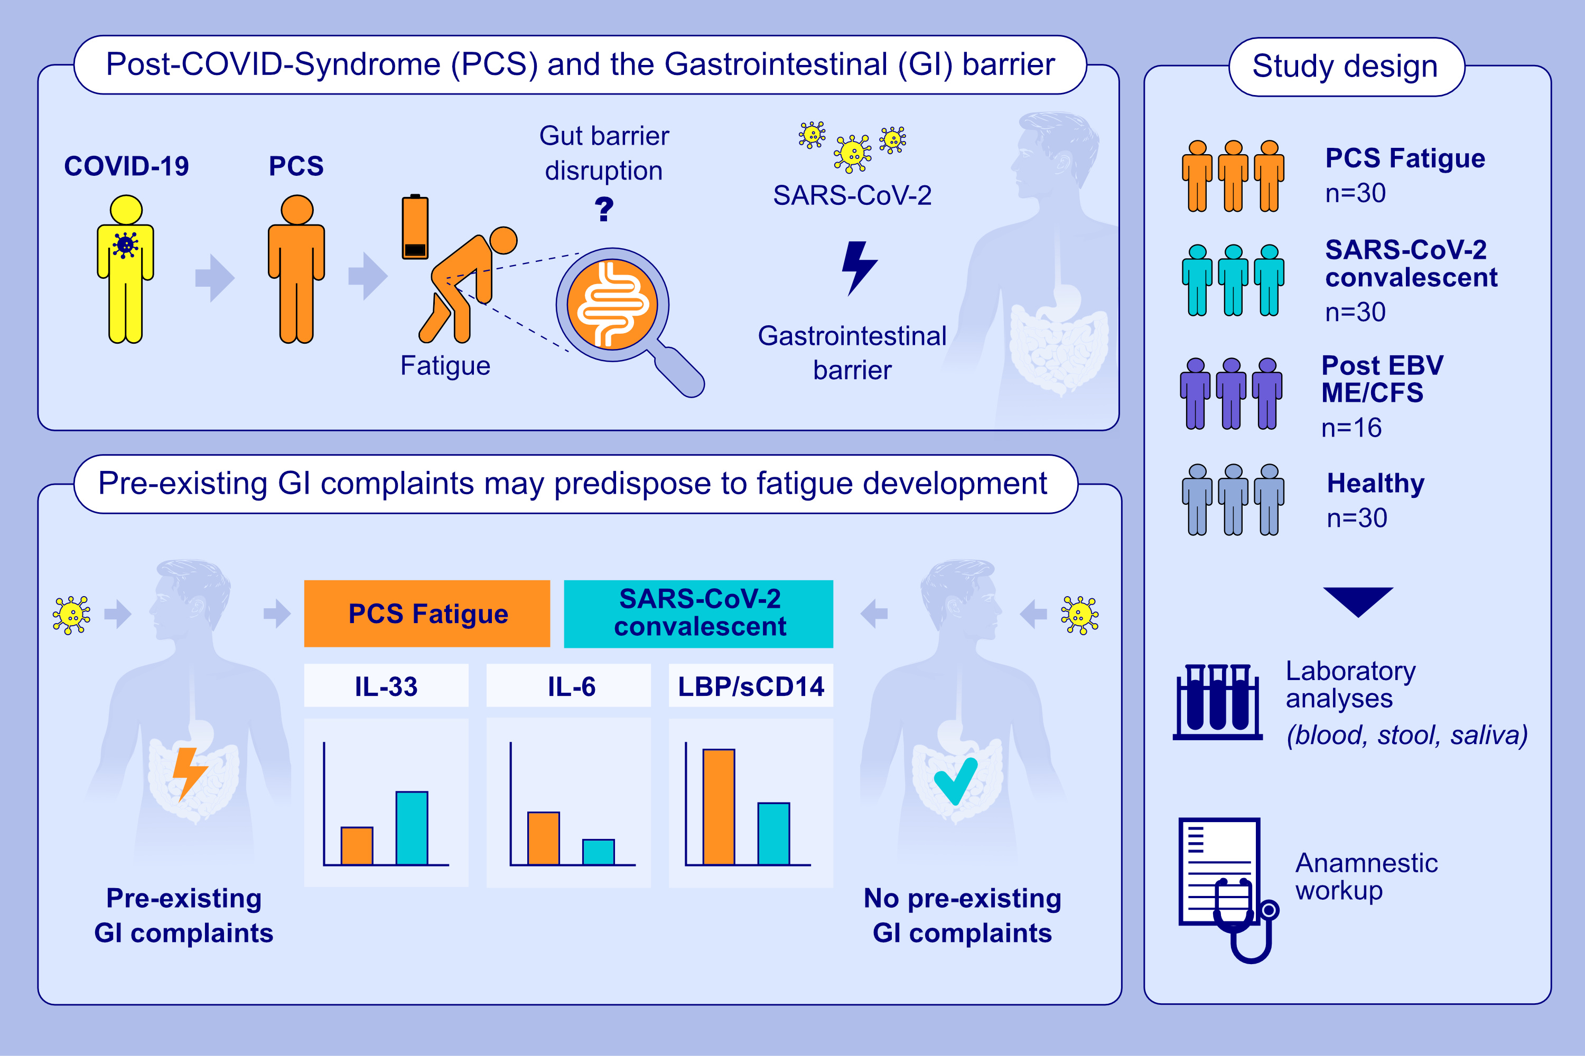
Gastrointestinal Barrier Disruption in Post-COVID Syndrome Fatigue Patients
Johanna Rohrhofer, Viktoria Wolflehner, Johannes Schweighardt, Larissa Koidl, Michael Stingl, et al.
Allergy. 2025;pages: 2610-2621
https://doi.org/10.1111/all.16593
© 2019 EAACI and John Wiley and Sons A/S. Published by John Wiley and Sons Ltd.
Notes:
HIGHLIGHTS
• The SARS-CoV-2 infection on the GI is associated with the development of PCS Fatigue.
• Pre-existing GI complaints may predispose to fatigue development.
• Monitoring GI symptoms and markers before, during and after SARS-CoV-2 infection is crucial for identifying predictive clinical phenotypes in PCS Fatigue.

