Slide 1
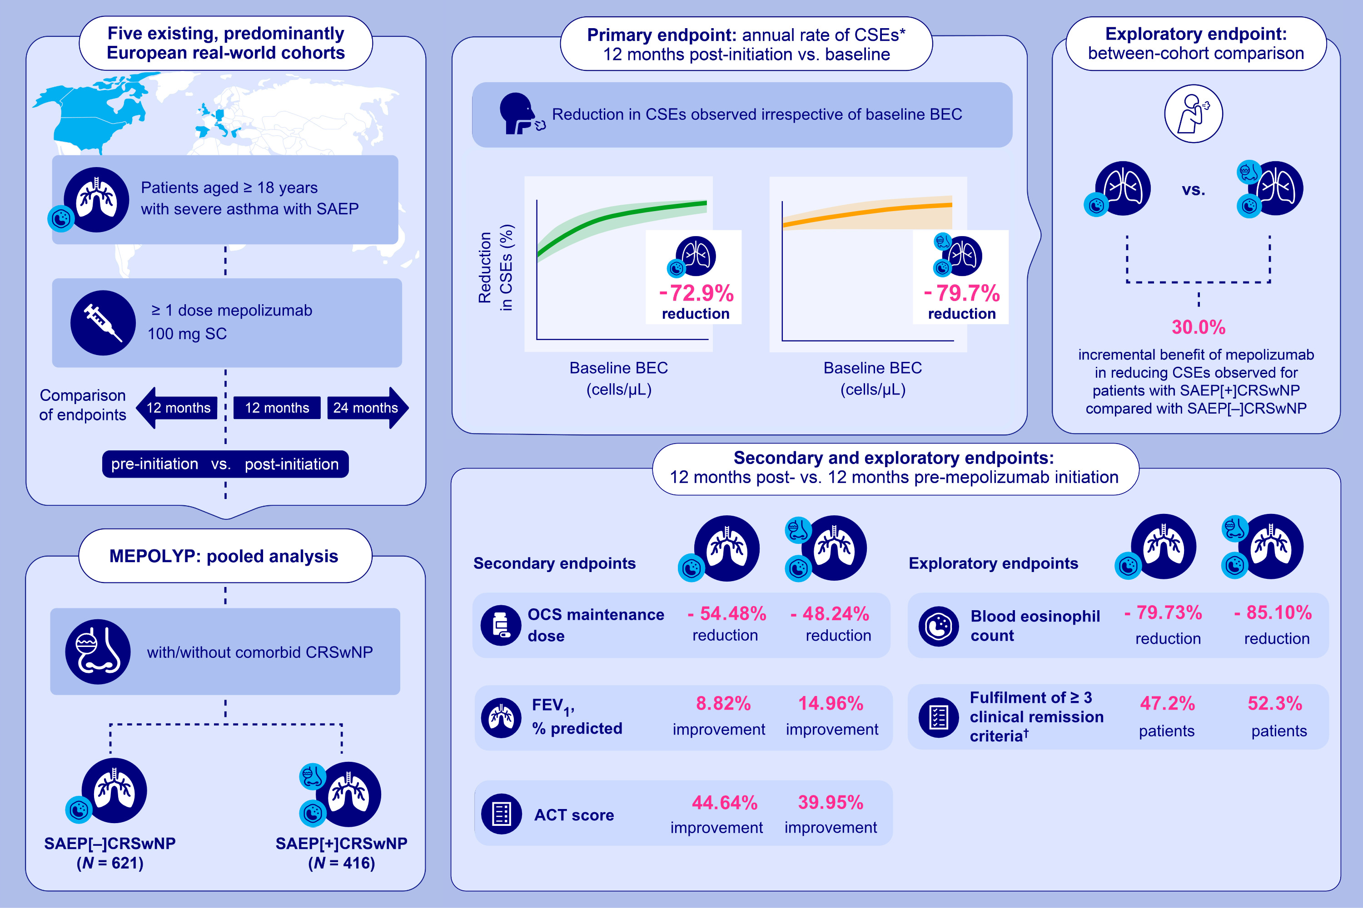
Mepolizumab Effectiveness in Severe Asthma With/Without Chronic Rhinosinusitis With Nasal Polyps: Real-World Pooled Analysis
Florence Schleich, Stelios Loukides, Rekha Chaudhuri, Joerg D. Leuppi, Enrico Heffler, et al.
Allergy. 2025; pages: 2557-2571
https://doi.org/10.1111/all.16618
© 2019 EAACI and John Wiley and Sons A/S. Published by John Wiley and Sons Ltd.
Notes:
HIGHLIGHTS
• MEPOLYP was a pooled analysis of 1037 patients with SAEP[±]CRSwNP.
•Mepolizumab was associated with a reduction in CSEs, OCS use and BEC, and improved lung function and ACT score.
• Over 47% of patients fulfilled ≥3 clinical remission criteria.
•When compared, there was a 30.0% incremental benefit of mepolizumab in reducing CSEs for patients with SAEP[+]CRSwNP, compared with SAEP[–]CRSwNP.

