Slide 1
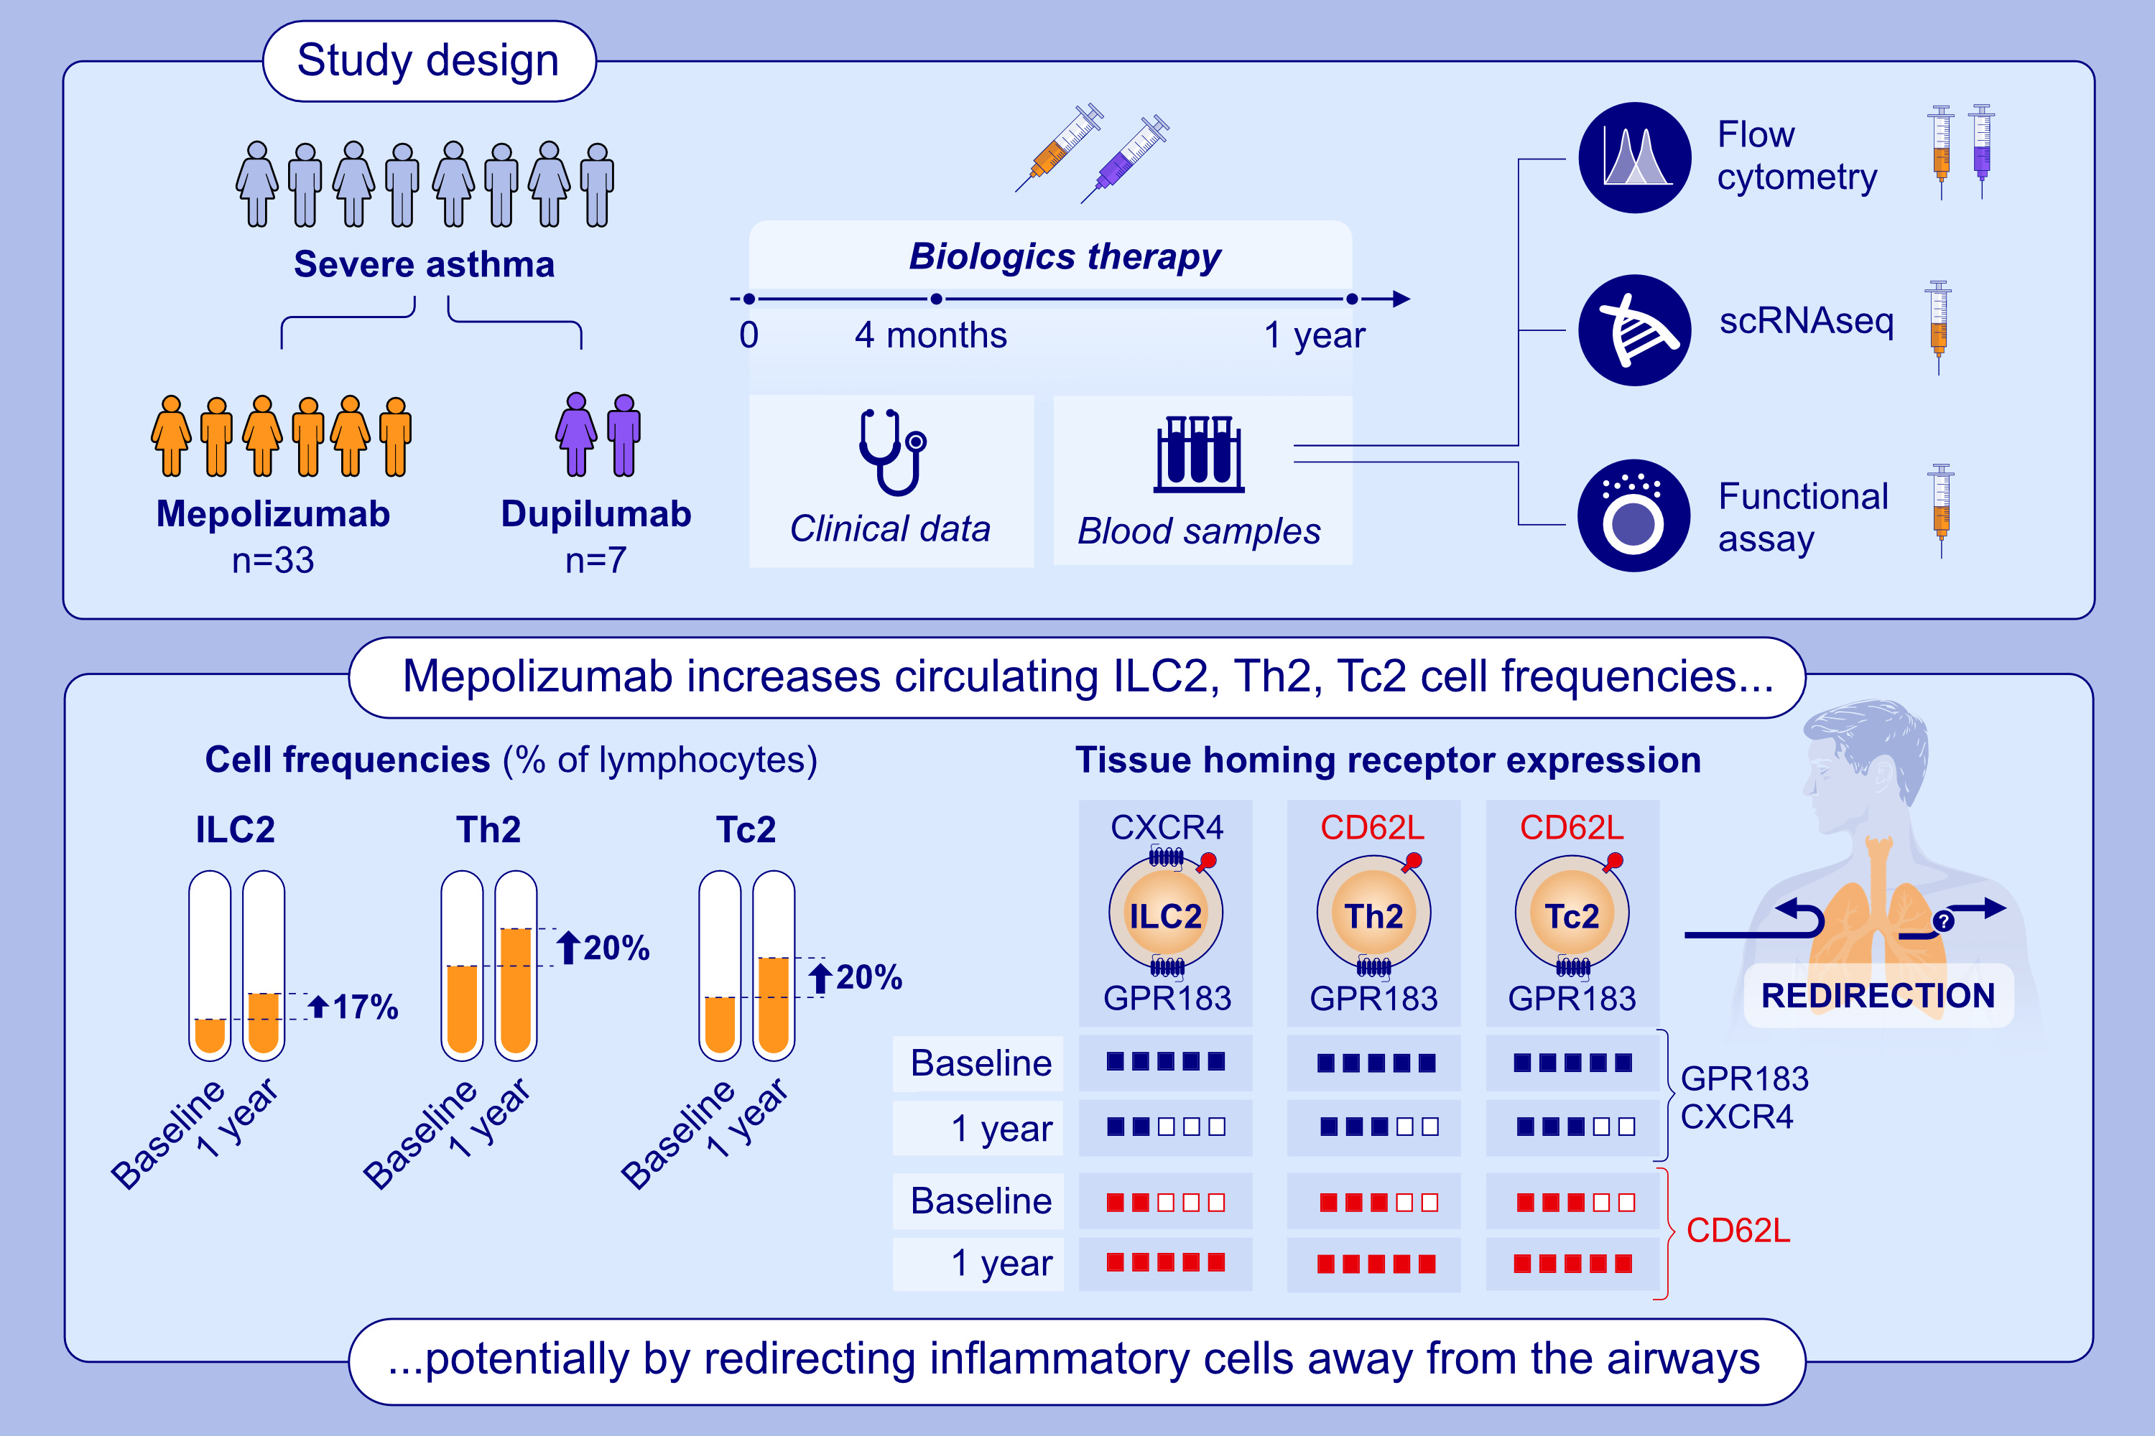
High-Dimensional Analysis of Type 2 Lymphocyte Dynamics During Mepolizumab or Dupilumab Treatment in Severe Asthma
Lorenz Wirth, Whitney Weigel, Christopher T. Stamper, Johan Kolmert, Sabrina de Souza Ferreira, et al.
Allergy. 2025; pages: 2541-2556
https://doi.org/10.1111/all.16633
© 2019 EAACI and John Wiley and Sons A/S. Published by John Wiley and Sons Ltd.
Notes:
HIGHLIGHTS
• We profiled PBMCs in severe asthma patients at baseline and after initiating treatment with mepolizumab or dupilumab. •Mepolizumab treatment increases ILC2, Th2 and Tc2 cell frequencies, skewing ILC2 towards CD117low and Th2/Tc2 cells towards a central memory phenotype. •Type 2 lymphocytes in mepolizumab-treated patients display altered expression of tissue-homing receptors and produce more type 2 cytokines in vitro.

