Slide 1
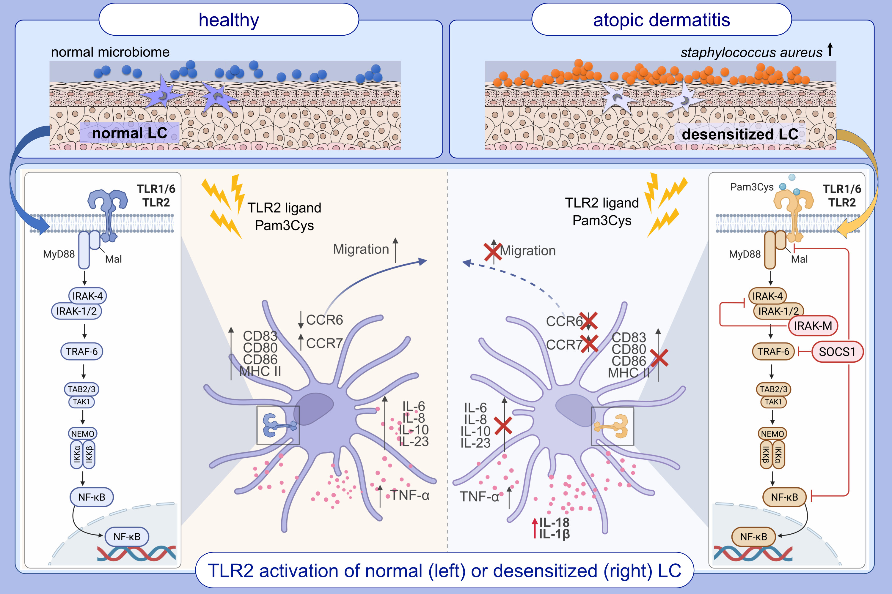
Langerhans Cell Modulation in Atopic Dermatitis Is TLR2/SOCS1-Dependent and JAK Inhibitor-Sensitive
Yuxuan Deng, Nicole Leib, Sylvia Schnautz, Said Benfadal, Johannes Oldenburg, et al.
Allergy. 2025; pages:2586-2599
https://doi.org/10.1111/all.16641
© 2019 EAACI and John Wiley and Sons A/S. Published by John Wiley and Sons Ltd.
Notes:
HIGHLIGHTS
• Constitutive exposure to TLR2 ligands can modify Langerhans cell (LC) activation capacity and outcome, being similar to LC in atopic dermatitis skin. • While maturation marker and migration are impaired, the cytokine profile switches and favours AD related Il-1 and IL-18. • This modification is mechanistically mediated by increase of inhibitory molecules SOCS1 and IRAK-M and sensitive to JAK inhibitors.

