Slide 1
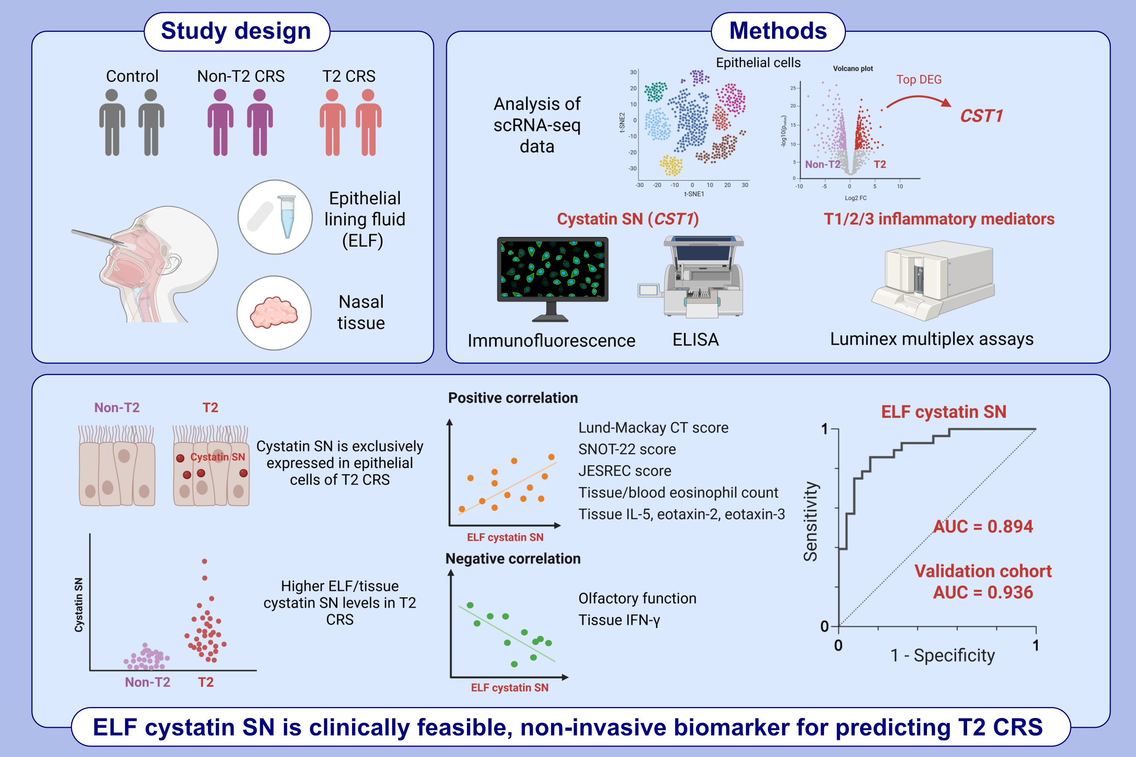
Epithelial Lining Fluid Cystatin SN is a Noninvasive Biomarker for Predicting Type 2 Chronic Rhinosinusitis
Seojin Moon, Sungmin Moon, Sol Lee, Gyeongyeob Kim, Min-Seok Koo, et al.
Allergy. 2025;pages:2572-2585
https://doi.org/10.1111/all.16652
© 2019 EAACI and John Wiley and Sons A/S. Published by John Wiley and Sons Ltd.
Notes:
HIGHLIGHTS
• Cystatin SN is highly expressed in the epithelial lining fluid (ELF) of patients with type 2 (T2) chronic rhinosinusitis (CRS). • ELF cystatin SN expression correlates with nasal T2/eosinophilic inflammation and impaired olfactory function. • ELF cystatin SN is a non-invasive biomarker for predicting T2 CRS with superior accuracy.

