Slide 1
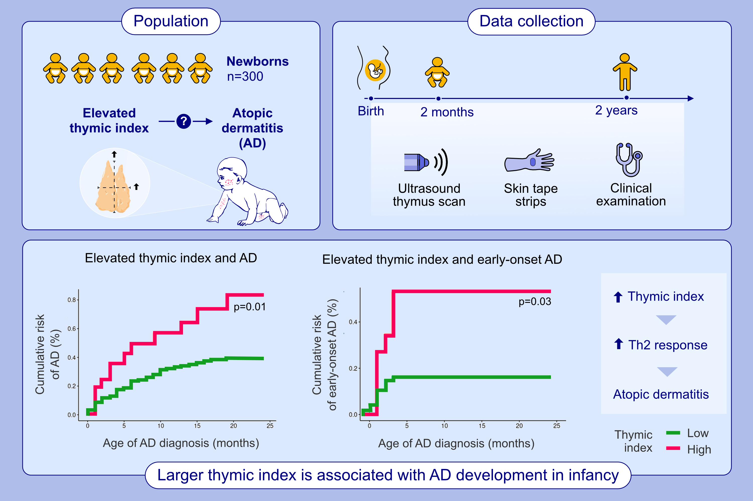
Large Thymus Size at 2 Months Is Associated With Increased Risk of Atopic Dermatitis at Age 2
Iben Frier Ruge, Maria Rasmussen Rinnov, Mie Sylow Liljendahl, Maria Zurek Munk-Madsen, Anne-Sofie Halling, et al.
Allergy. 2025;pages: 2600-2609
https://doi.org/10.1111/all.16673
© 2019 EAACI and John Wiley and Sons A/S. Published by John Wiley and Sons Ltd.
Notes:
HIGHLIGHTS
• A cohort of 300 term newborns was followed until age 2 for atopic dermatitis, with thymus size assessed at 2 months. • Elevated thymic index (≥90th percentile) was associated with increased risk and earlier onset of AD. • Findings suggest that early thymic activity, via enhanced T-cell maturation, may contribute to Th2 skewing and AD pathogenesis.

