Slide 1
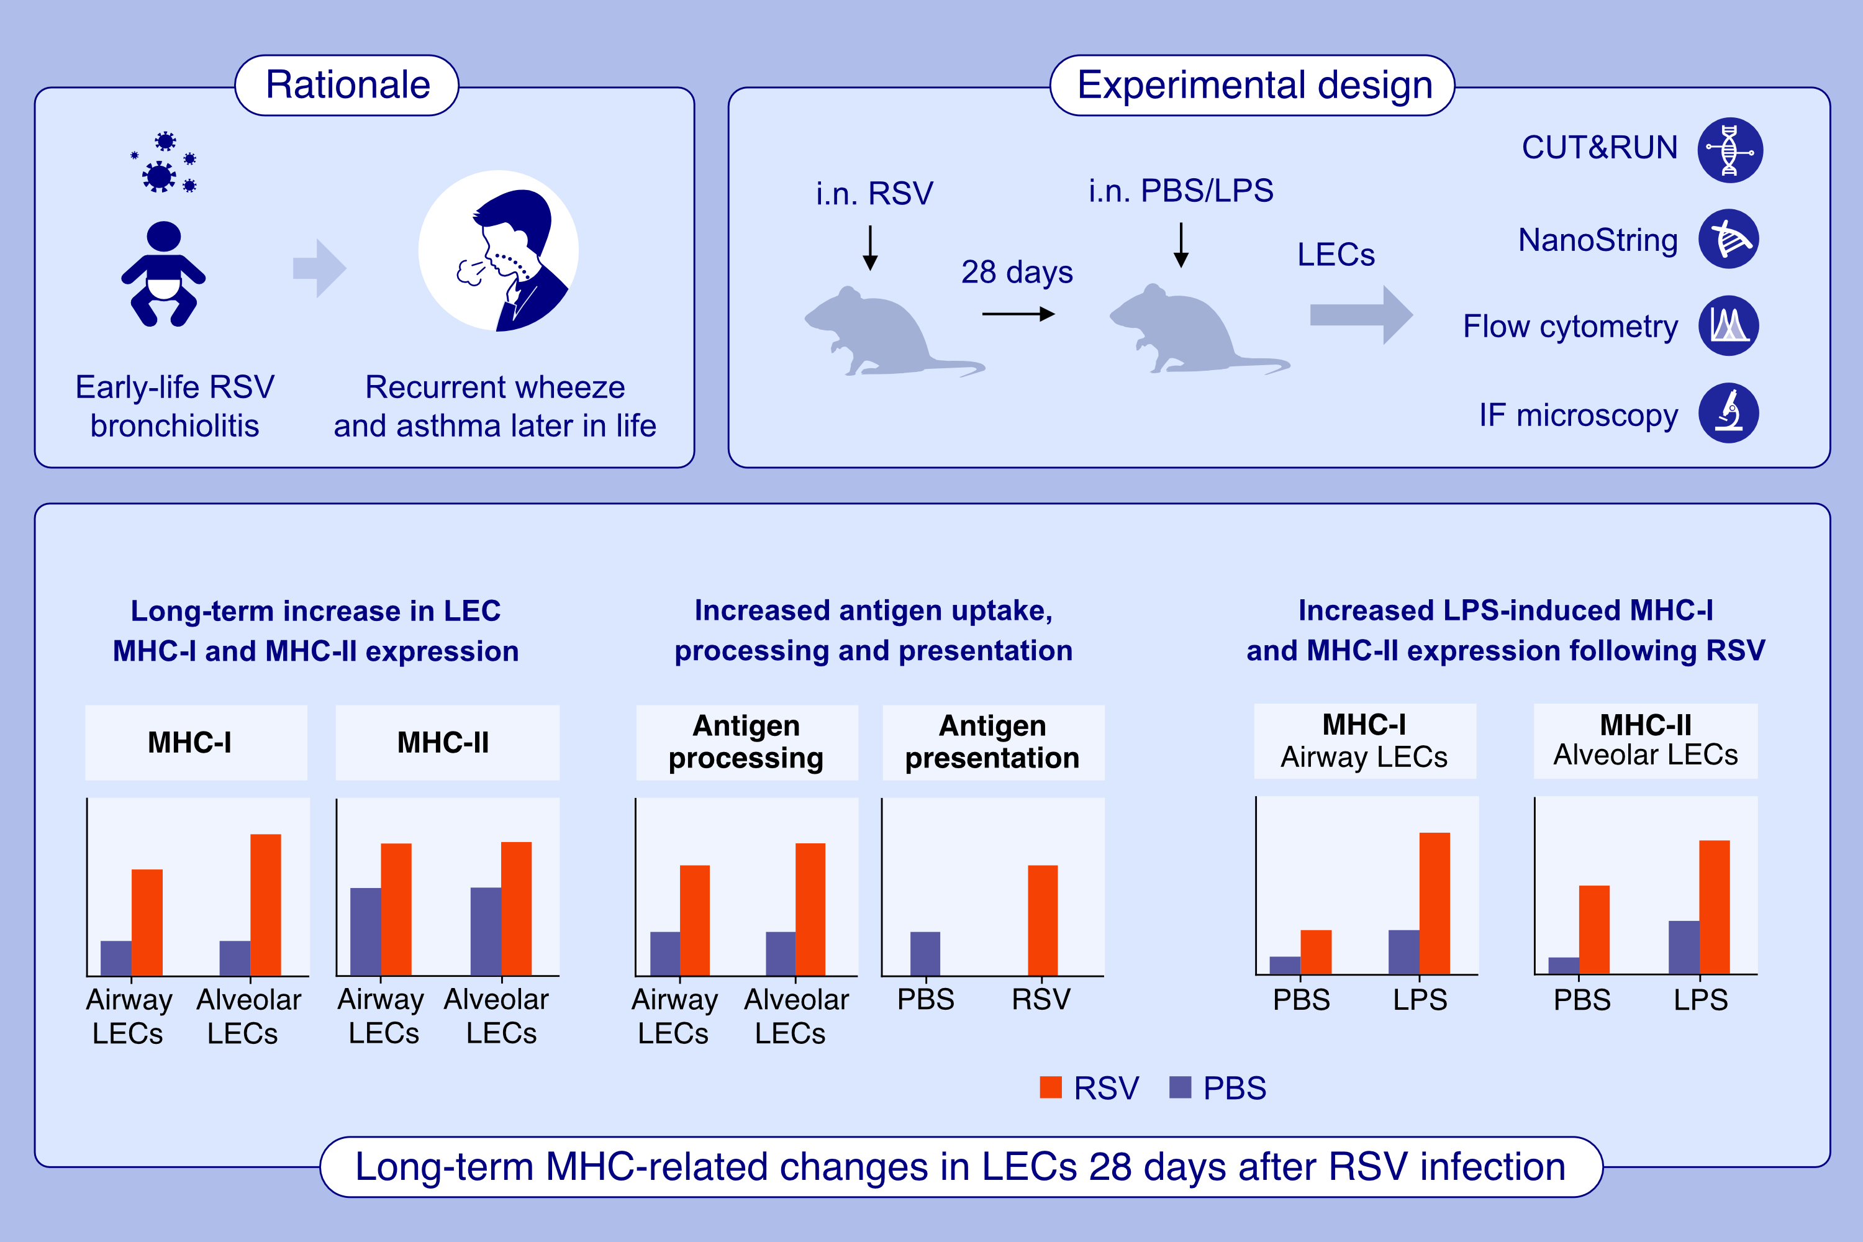
Epithelial Memory After Respiratory Viral Infection in Mice Results in Prolonged Enhancement of Antigen Presentation
Piotr P. Janas, Wouter T'Jonck, Matthew O. Burgess, Maximilian Reck, Caroline Chauché, et al.
Allergy. 2025;pages:2501-2518
https://doi.org/10.1111/all.16683
© 2019 EAACI and John Wiley and Sons A/S. Published by John Wiley and Sons Ltd.
Notes:
HIGHLIGHTS
• RSV infection induces lasting epigenetic and transcriptional changes in LECs, upregulating MHC-I and MHC-II, further amplified by LPS exposure.
• This is accompanied by increased antigen uptake, processing and presentation. • These persistent alterations may influence immune responses, potentially impacting both immunity to infection and respiratory allergy development.

