Slide 1
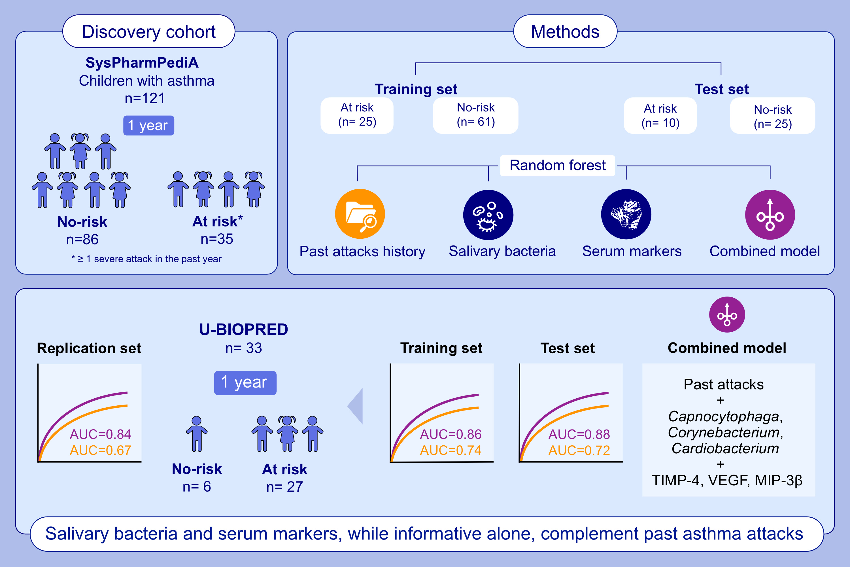
Complementary Predictors for Asthma Attack Prediction in Children: Salivary Microbiome, Serum Inflammatory Mediators, and Past Attack History
Shahbazi Khamas, S., Brinkman, P., Neerincx, A.H., Vijverberg, S.J.H., Hashimoto, S.et al.
Allergy.2026.Pages:413-426
doi.org/10.1111/all.70004
© 2019 EAACI and John Wiley and Sons A/S. Published by John Wiley and Sons Ltd.
Notes:
HIGHLIGHTS
• In this two-phase study, school-aged children were classified as at-risk or no-risk based on severe attacks during one-year follow-up. Four types of prediction models were developed.
• Salivary bacteria and serum inflammatory markers, while informative alone, complement past asthma attacks in predicting future attacks risk.
• Combined model, outperformed single-data models, achieving AUROCC ~0.87 in discovery and ~0.84 in replication. .

