Slide 1
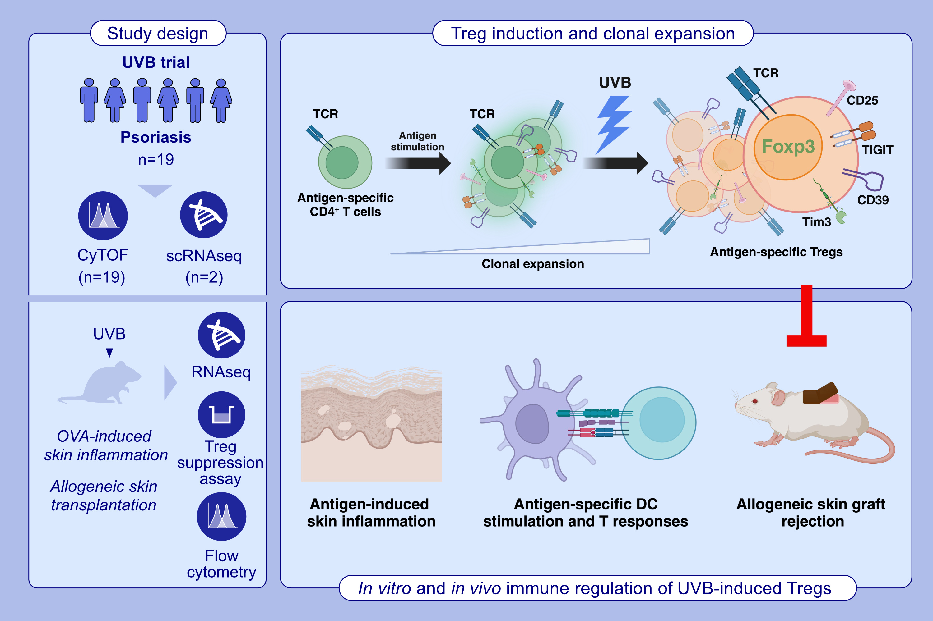
Narrowband Ultraviolet B Induces Peripheral Regulatory T Cells to Exert Antigen-Specific Immune Suppression
Chun-Hao Lu Ching-Hui Tsai Iquo O. Phillip Pei-Chuan Chiang Shao-Han Chang et al.
Allergy. 2026. Pages:356-387
doi.org/10.1111/all.70019
© 2019 EAACI and John Wiley and Sons A/S. Published by John Wiley and Sons Ltd.
Notes:
HIGHLIGHTS
• Our research demonstrates that UVB exposure generates Tregs exhibiting T cell receptor (TCR) activation phenotypes.
• These UVB-induced Tregs suppress immune responses in an antigen-specific manner.
• Furthermore, they are differentiated from other CD4+ T cells and undergo clonal expansion.
• These findings offer new insights into the potential therapeutic use of UVB for antigen-related inflammatory conditions. .

