Slide 1
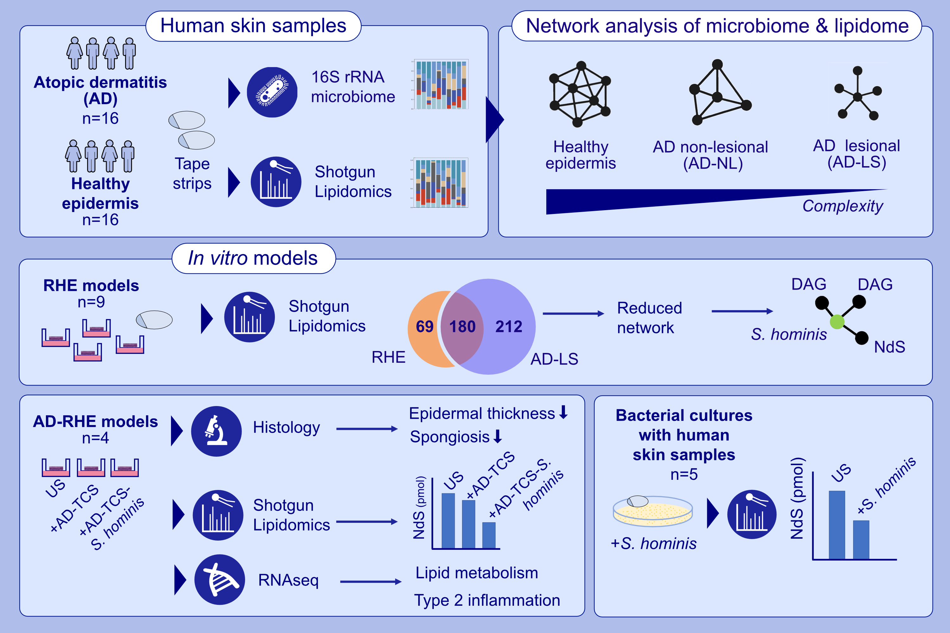
Skin Lipid–Microbe Interplay Links Staphylococcus hominis to Barrier Control in Adult Atopic Dermatitis
Madhumita Bhattacharyya Felix Lauffer Manja Jargosch Kristina Frey Mahsa Shahidi Dadras et al.
Allergy. 2026, Pages:454-467
https://doi.org/10.1111/all.70028
© 2019 EAACI and John Wiley and Sons A/S. Published by John Wiley and Sons Ltd.
Notes:
HIGHLIGHTS
• This study investigates mutual interaction of skin microbes and surface lipids in AD using the advanced method of shotgun lipidomics with ultra-broad coverage of lipids and 16S amplicon sequencing of tape strips taken from lesional and non-lesional AD and healthy controls.
• Multi-omics integration of microbiome and lipidome from lesional and non-lesional AD as well as healthy skin reveals disease-specific interaction networks.
• S.hominis correlates with key lipid species and functional validation in RHE and bacterial culture models confirms S.

