Slide 1
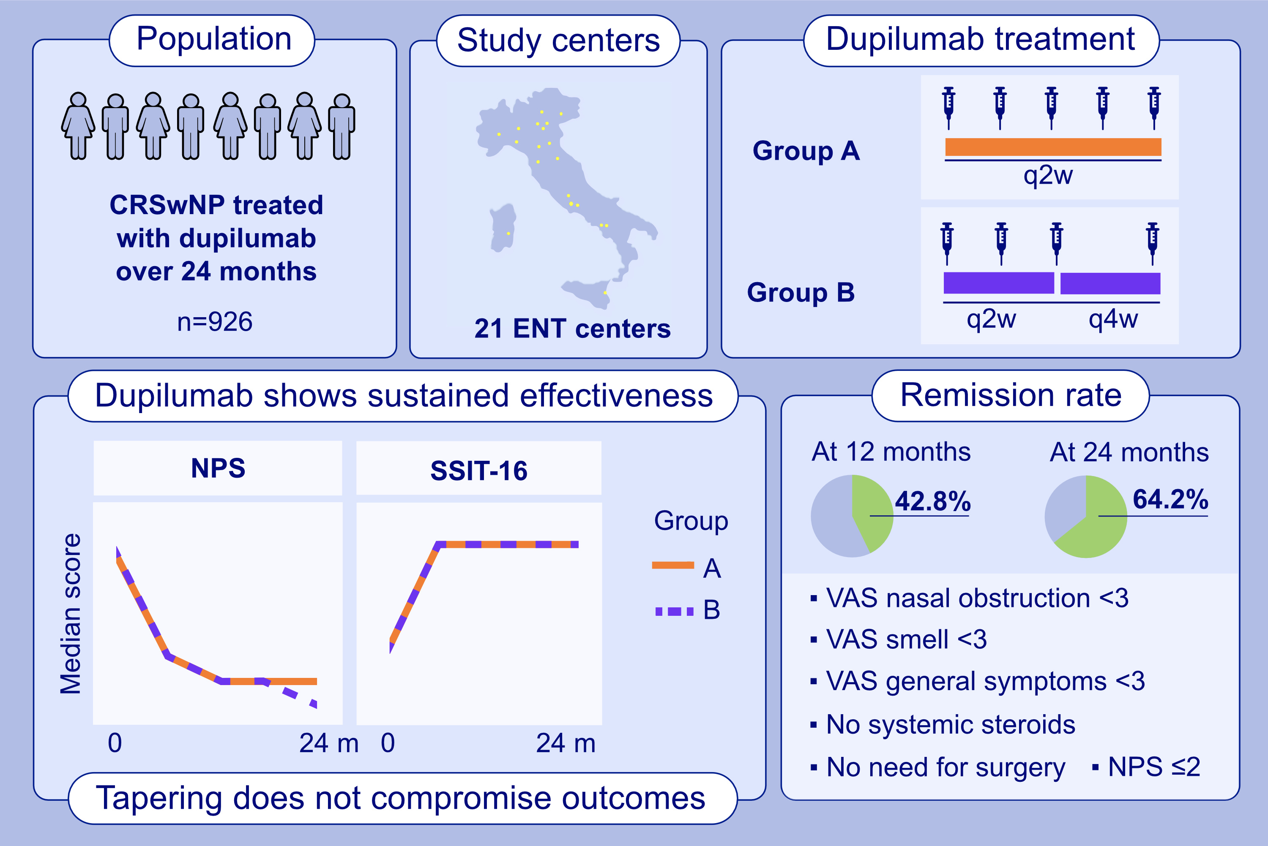
Two-Year Turning Point With Dupilumab in Chronic Rhinosinusitis with Nasal Polyps: Control, Remission, and Tapering Dosage
Eugenio De Corso Claudio Montuori Carlotta Pipolo Ignazio La Mantia Ernesto Pasquini et al.
Allergy. 2026,Pages: 388-401
https://doi.org/10.1111/all.70032
© 2019 EAACI and John Wiley and Sons A/S. Published by John Wiley and Sons Ltd.
Notes:
HIGHLIGHTS
• This is the largest real-life, confirming two-year efficacy and safety of dupilumab in CRSwNP (N=926 patients).
• All sino-nasal outcomes, including NPS and SSIT-16, improved in both patients receiving dupilumab q2w and those extending the interval dose to q4w.
• Two sets of criteria were proposed to define sustained control and remission status.
• Based on these criteria sets, the lowest observed remission rate was 64.2% at 24 months.
.

