Slide 1
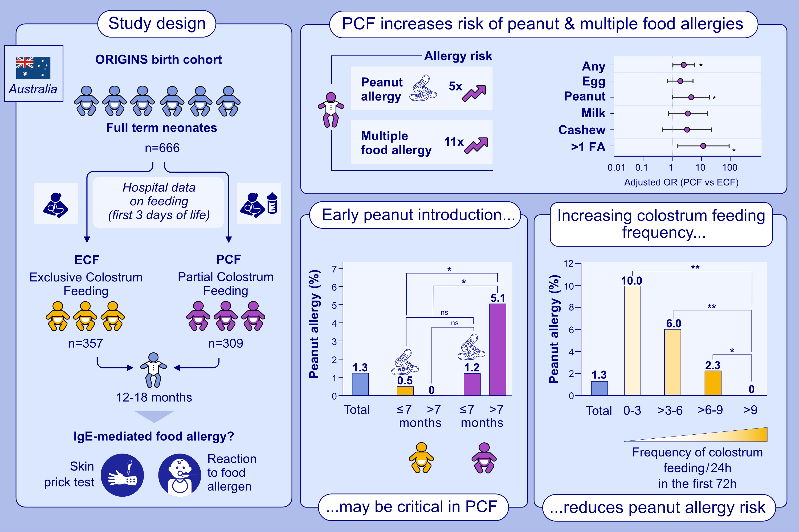
Colostrum as a Protective Factor Against Peanut Allergy: Evidence From a Birth Cohort
Bhasin, M., Cooper, M., Macchiaverni, P., Joys, R.S., O'Sullivan, T.A.,
Allergy. 2026,Pages: 552-562
https://doi.org/10.1111/all.70043
© 2019 EAACI and John Wiley and Sons A/S. Published by John Wiley and Sons Ltd.
Notes:
HIGHLIGHTS
• This study investigates whether partial colostrum feeding (PCF) due to formula supplements in the first 3 days increases the risk of food allergy beyond cow's milk.
• PCF infants showed increased risk of peanut allergy and multiple food allergies compared to exclusively colostrum-fed (ECF) infants.
• Risk was greater in PCF infants with later (>7 months) peanut introduction, while ECF infants maintained low risk regardless of timing.
• No case of peanut allergy was found in infants fed more than 9 colostrum feeds per 24 hours in the first 72 hours, independent of formula feeding. .

