Slide 1
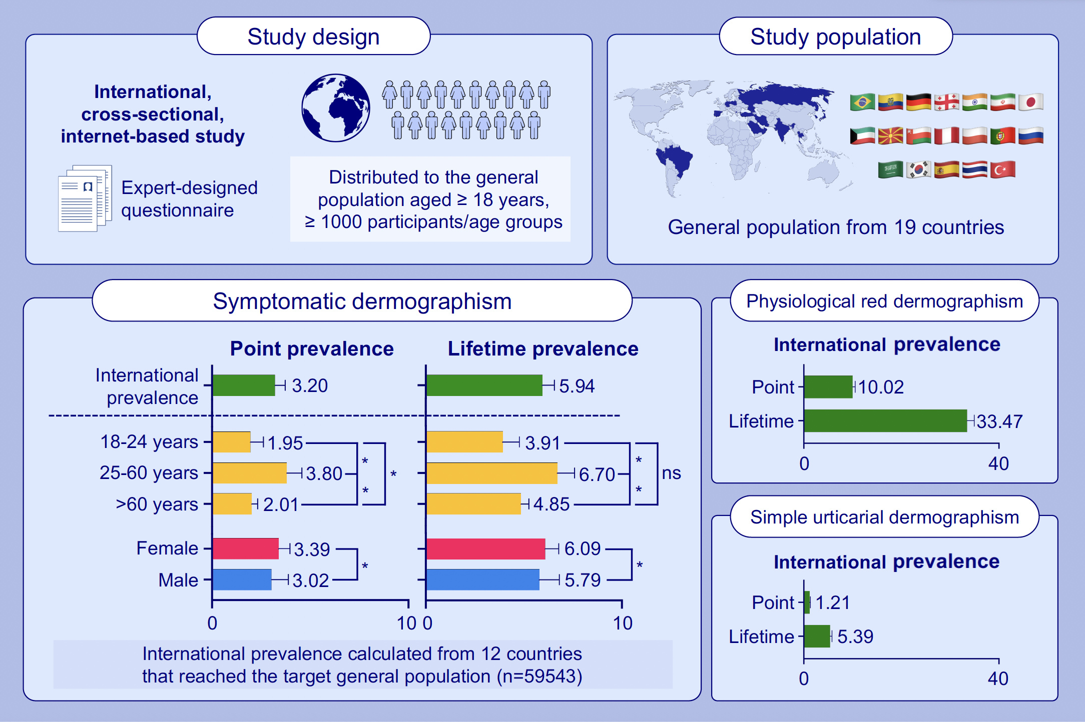
The Prevalence of Symptomatic Dermographism: Results of the International UCARE PREVALENCE-D Study
Kanokvalai Kulthanan Jonathan A. Bernstein Michael Rudenko Pascale Salameh Chulaluk Komoltri et al.
Allergy. 2026;Pages: 468-479
https://doi.org/10.1111/all.70047
© 2019 EAACI and John Wiley and Sons A/S. Published by John Wiley and Sons Ltd.
Notes:
HIGHLIGHTS
• An online expert-designed questionnaire estimated international prevalence of dermographism.
• Symptomatic dermographism, physiological red dermographism, and simple urticarial dermographism exhibit distinct prevalence patterns across age groups, sex, and geographic regions.
• Symptomatic dermographism has an international point prevalence of 3.20% (95% CI 2.68%-3.73%) and a lifetime prevalence of 5.94% (95% CI 5.32%-6.56%), with significantly higher rates in females and the working-age group. .

