Slide 1
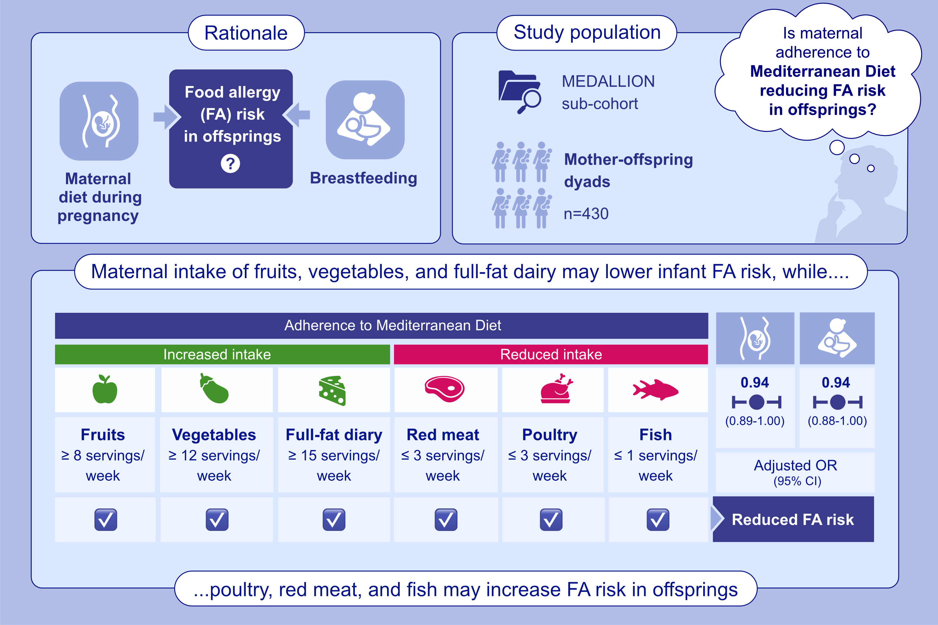
Adherence to Mediterranean diet during pregnancy, breastfeeding and development of food allergy in the offspring: results from the MEDALLION cohort study
Vassilopoulou, E., Karastogiannidou, C., Comotti, A., Agostoni, C., Maragkou, M.-K., et al.
Allergy. 2026, Pages:563-572
https://doi.org/10.1111/all.70054
© 2019 EAACI and John Wiley and Sons A/S. Published by John Wiley and Sons Ltd.
Notes:
HIGHLIGHTS
• This study analyzed data from a sub-cohort of the MEDALLION study to examine the association between maternal adherence to the Mediterranean diet and the development of food allergy in offspring.
• Maternal dietary intake during pregnancy and lactation was assessed using the validated MedDiet Score, together with individual food group consumption; multiple logistic regression models were applied.
• Integrating Mediterranean diet principles into guidelines, with an emphasis on increased consumption of fruits, full-fat dairy, and vegetables, may help lower the risk of food allergy. .

