Slide 1
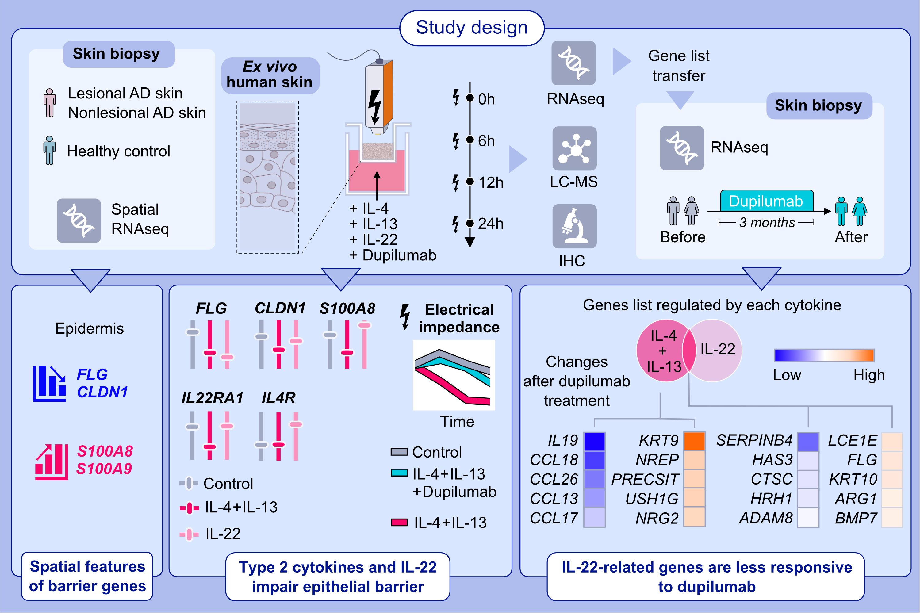
Distinct Roles of IL-4, IL-13, and IL-22 in Human Skin Barrier Dysfunction and Atopic Dermatitis
Paolo D'Avino Juno Kim Manru Li Philipp Gessner Patrick Westermann et al.
Allergy. 2026; Pages: 480-497
https://doi.org/10.1111/all.70060
© 2019 EAACI and John Wiley and Sons A/S. Published by John Wiley and Sons Ltd.
Notes:
HIGHLIGHTS
• This study reports the distinct effects of IL-4, IL-13, and IL-22 on bio-stabilized human skins with intact barriers and immune cells.
• IL-4, IL-13, and IL-22 upregulate inflammatory mediators, disrupt skin barrier integrity, and reciprocally modulate IL-4Rα and IL-22Rα1 receptors.
• Both type 2 cytokine- and IL-22–related genes show limited response to anti-IL-4Rα antibody (dupilumab), revealing complex immune-barrier interactions in atopic dermatitis. .

