Slide 1
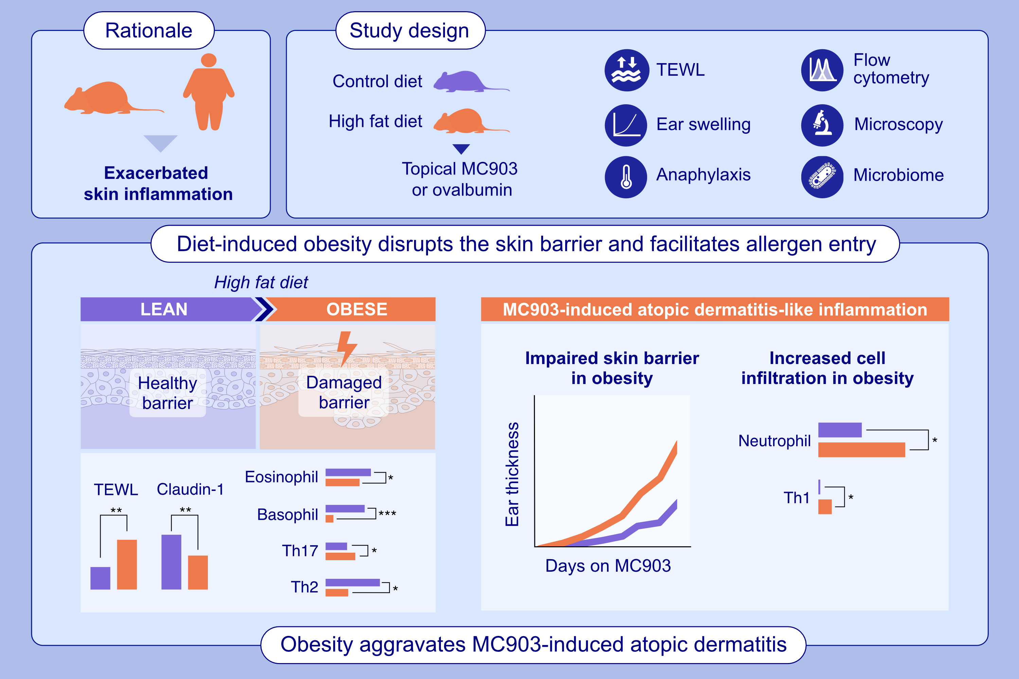
Obesity impairs skin barrier function and facilitates allergic sensitization in mice
Martinek, A., Deinzer, A., Gerlach, R.G., Petzold, J., Semmler, L., et al.
Allergy. 2026, Pages: 498-512
https://doi.org/10.1111/all.70067
© 2019 EAACI and John Wiley and Sons A/S. Published by John Wiley and Sons Ltd.
Notes:
HIGHLIGHTS
• Diet-induced obesity increases transepidermal water loss and compromises barrier function through downregulation of tight junctions and desmosomes.
• During obesity, MC903 elicits a mixed Th1/2/17-immune response in the skin leading to aggravated ear swelling.
• The compromised skin barrier during obesity facilitates allergen penetration and cutaneous sensitization. .

