Slide 1
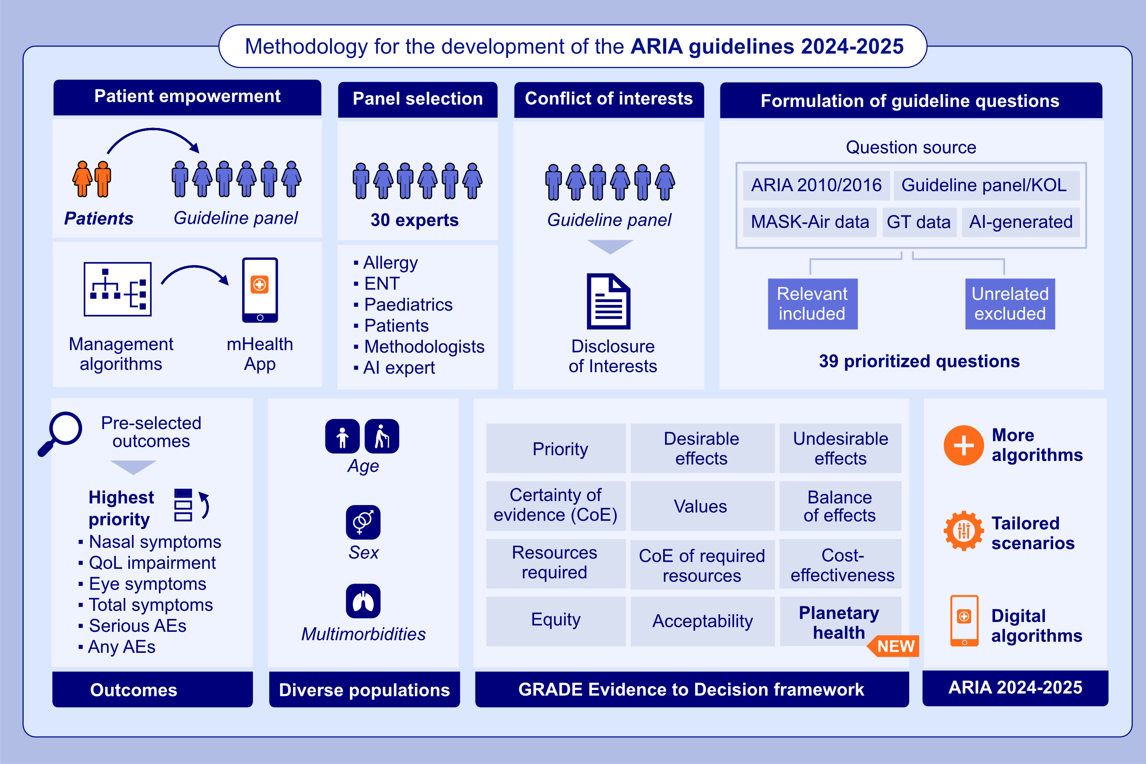
Methodology for the development of the Allergic Rhinitis and its Impact on Asthma (ARIA) 2024-2025 guidelines: From Evidence-to-Decision frameworks to digitalised shared decision-making algorithms
Bousquet, J., Sousa-Pinto, B., Vieira, R.J., Schünemann, H.J., Zuberbier, T., et al.
Allergy. 2026, Page: 427-453
https://doi.org/10.1111/all.70100
© 2019 EAACI and John Wiley and Sons A/S. Published by John Wiley and Sons Ltd.
Notes:
HIGHLIGHTS
• The Allergic Rhinitis and its Impact on Asthma (ARIA) group is working on the 2024-2025 update of its guidelines for the management of allergic rhinitis (ARIA 2024-2025).
• The ARIA 2024-2025 guidelines will follow GRADE methodology and will incorporate evidence from different sources, including systematic reviews and meta-analysis, mHealth data and pharmacovigilance data, among others.
• The ARIA 2024-2025 guidelines will be innovative, among others, by (i) being supported by artificial intelligence on aspects such as question generation, (ii) resulting in the production of digital algorithms for the management of allergic rhinitis, and (iii) considering planetary health.
.

