Slide 1
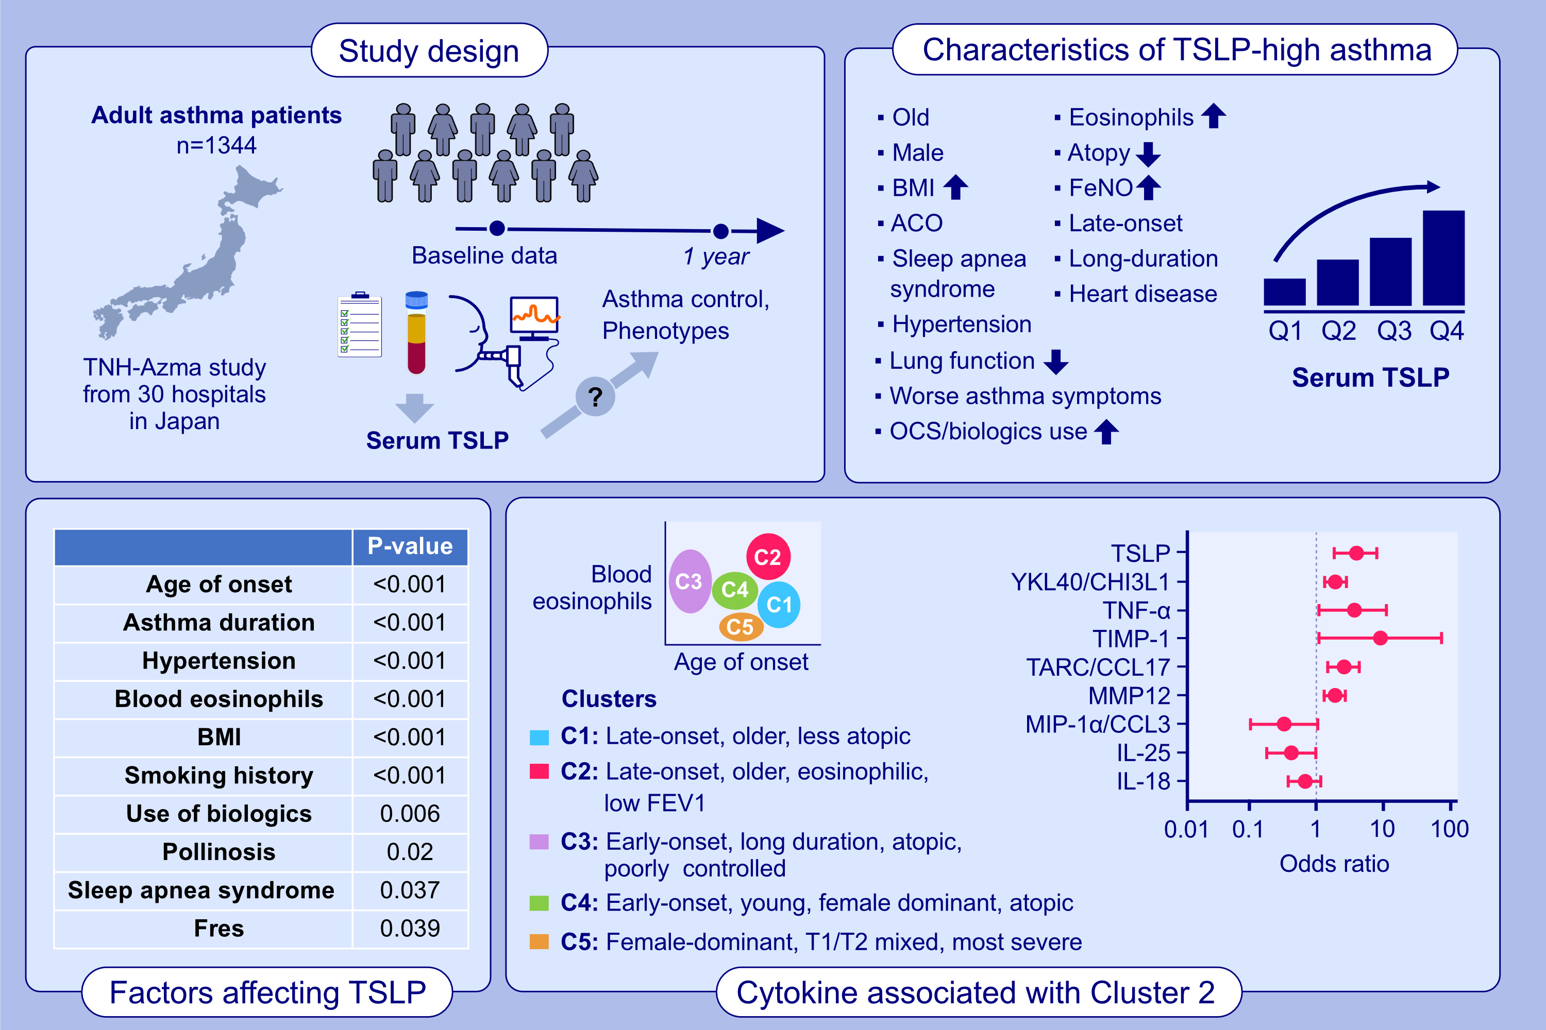
High Serum Thymic Stromal Lymphopoietin (TSLP) Is Characteristic of Late-Onset, Long-Duration, Eosinophilic Asthma
Maho Suzukawa Ken Ohta Hiroyuki Tashimo Osamu Narumoto Hiroya Hashimoto et al.
Allergy. 2026, Pages:402-412
https://doi.org/10.1111/all.70109
© 2019 EAACI and John Wiley and Sons A/S. Published by John Wiley and Sons Ltd.
Notes:
HIGHLIGHTS
• This study aimed to determine the characteristics of adult asthma with high serum TSLP and explore TSLP’s association with late-onset eosinophilic asthma phenotype.
• A high TSLP level was positively associated with later asthma onset, longer asthma duration, hypertension, higher blood eosinophils, BMI, smoking history, use of biologics, sleep apnea syndrome, and high Fres, and was negatively associated with pollinosis.
• Among the serum cytokines, TSLP exhibited the strongest association with late-onset, eosinophilic asthma.
.

