Slide 1
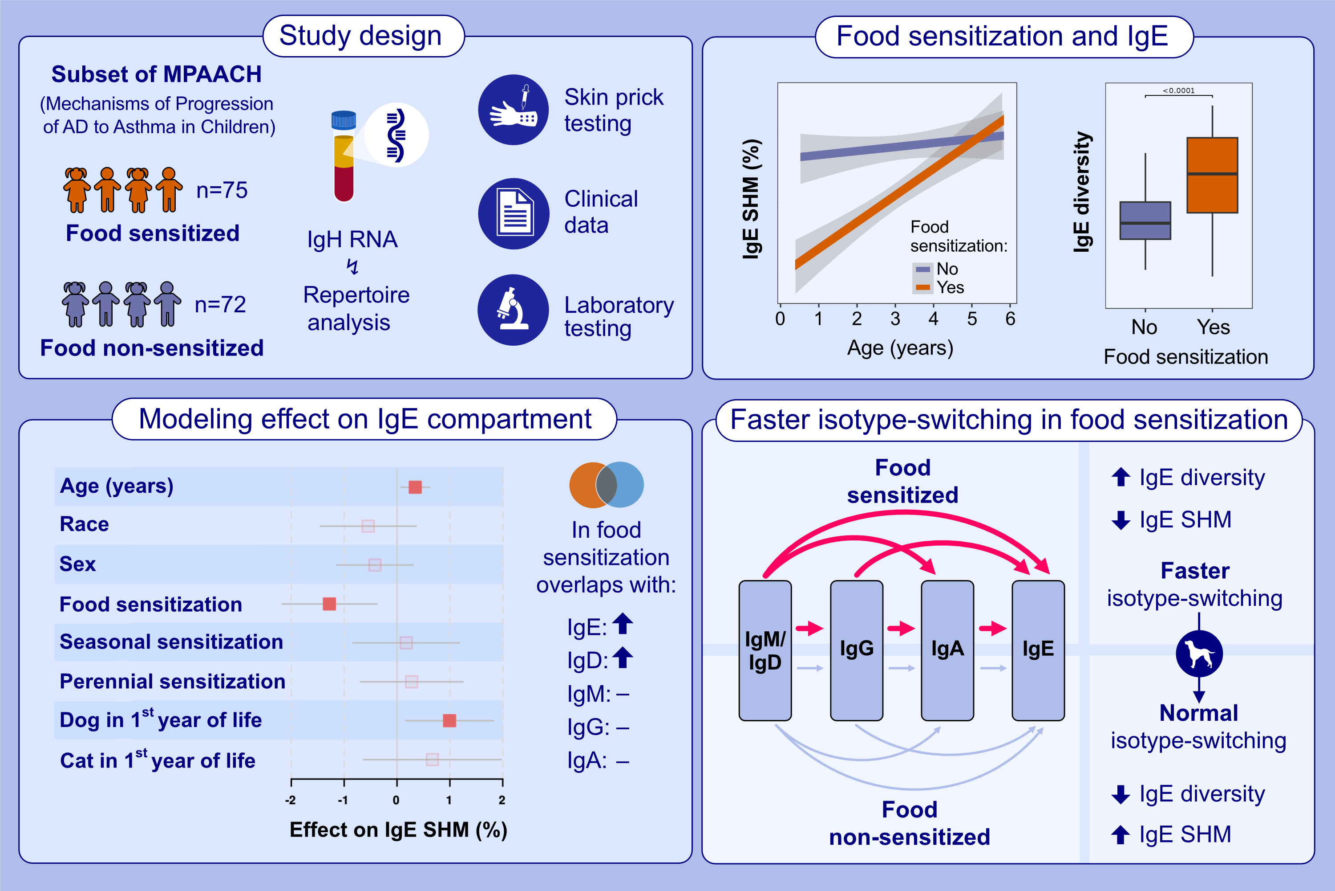
B cell repertoire of children with atopic dermatitis exhibit altered IgE maturation associated with allergic food sensitization
Gill, K.K., Moore, C., Nwogu, O., Kroner, J.W., Chang, W.-C., et al.
Allergy. 2026, Pages: 513-523
https://doi.org/10.1111/all.70150
© 2019 EAACI and John Wiley and Sons A/S. Published by John Wiley and Sons Ltd.
Notes:
HIGHLIGHTS
• IgH repertoire sequencing of a large atopic dermatitis cohort reveal reduced IgE somatic hypermutation and increased IgE diversity associated with food allergen sensitization.
• Presence of a dog during the first year of life is associated with increased IgE somatic hypermutation, possibly countering the effect of food sensitization.
• The above, plus increased overlap of the IgE compartment with other isotypes, suggest that isotype switching is faster/increased in food sensitized children. .

