Slide 1
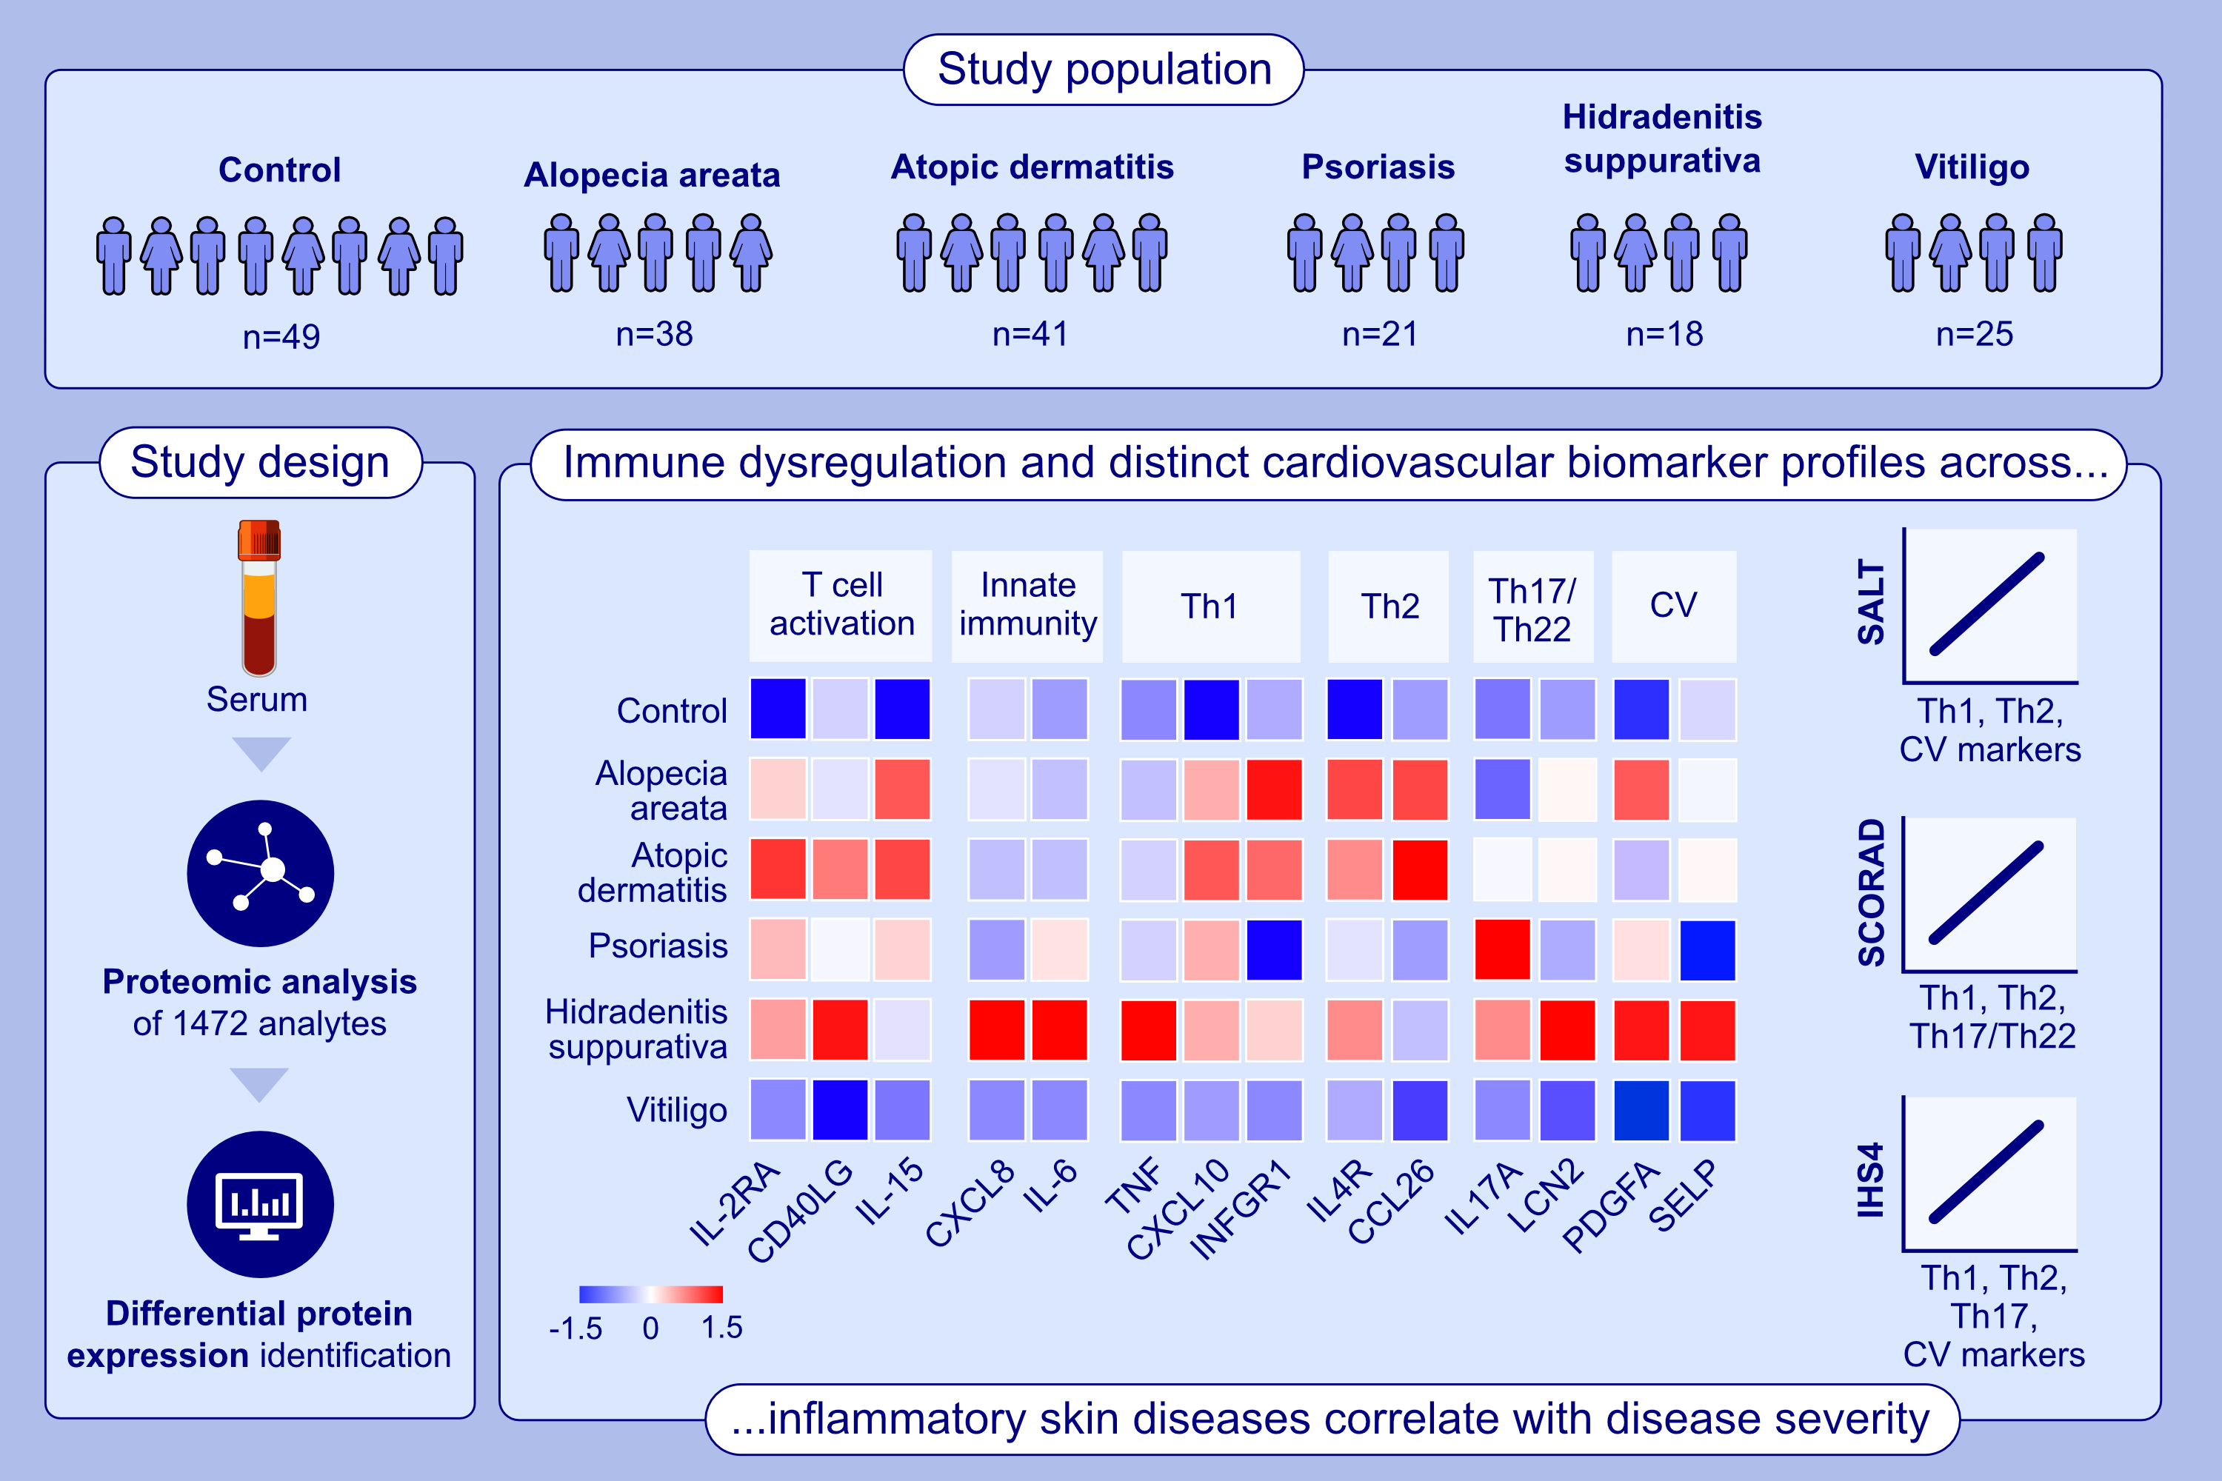
Large-scale blood proteomic analysis across different inflammatory skin conditions reveals extensive immune dysregulation with distinct biomarker profiles
Glickman, J.W., David, E., Shokrian, N., Hawkins, K., Duca, E.D., et al.
Allergy. 2026, Pages:524-538
https://doi.org/10.1111/all.70157
© 2019 EAACI and John Wiley and Sons A/S. Published by John Wiley and Sons Ltd.
Notes:
HIGHLIGHTS
• This study investigates proteomic expression across the most common inflammatory skin diseases.
• Hidradenitis suppurativa patients exhibit the highest level of dysregulation in immune and cardiovascular biomarkers compared to healthy controls, followed by alopecia areata, atopic dermatitis, psoriasis, and vitiligo.
• Spearman analysis reveals multiple positive correlations between key immune markers and respective clinical severity scores (e.g., SALT, SCORAD, IHS4). .

