Slide 1
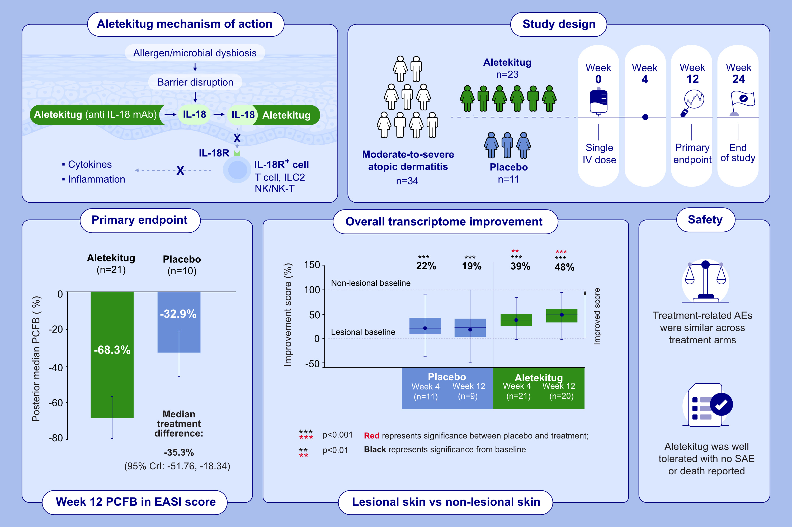
Clinical and Molecular Effect of the Anti–IL-18 Antibody Aletekitug in Adults With Atopic Dermatitis
Ellis, J., Fortunato, L., Wajdner, H., Del Duca, E., Barnard, J., et al.
Allergy.2026.Pages: 539-551
doi.org/10.1111/all.70172
© 2019 EAACI and John Wiley and Sons A/S. Published by John Wiley and Sons Ltd.
Notes:
HIGHLIGHTS
• At Week 12, aletekitug was associated with a -68.3% percentage change from baseline in EASI score.
• Aletekitug improved the transcriptional profile of lesional skin towards that of non-lesional skin at Week 4 and Week 12.
• Aletekitug was well-tolerated; no serious adverse event or death occurred, and no patient withdrew due to an adverse event..

