Slide 1
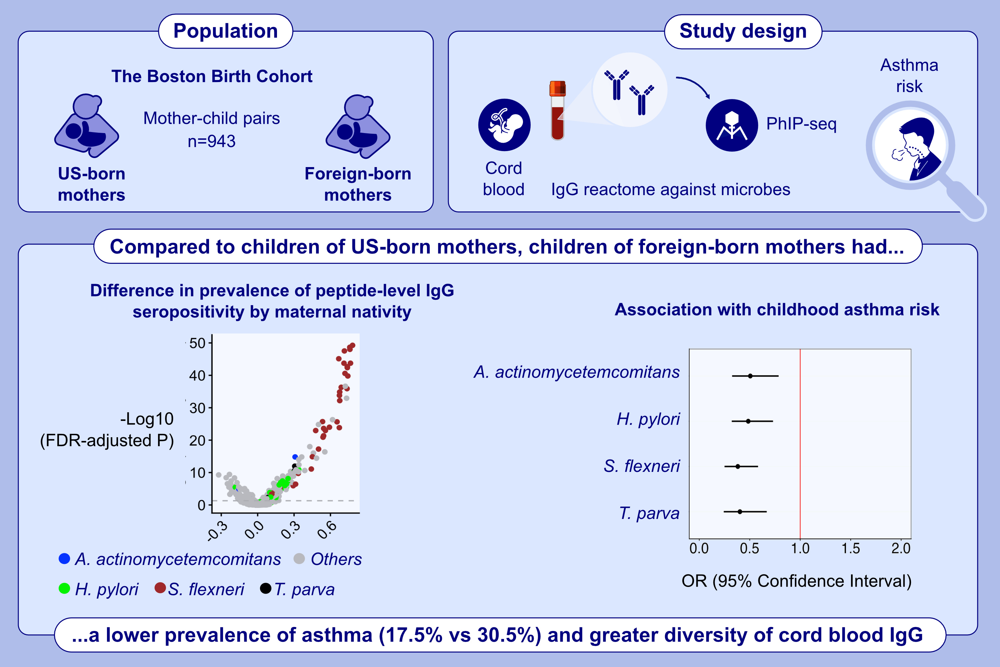
Modulation of cellular, molecular and humoral responses by PQ Grass 27600 SU for the treatment of seasonal allergic rhinitis: A Randomized Double Blind Placebo Control Exploratory Field Study
Janice A. Layhadi, Sviatlana Starchenka, Pieter-Jan De Kam, Elizabeth Palmer, Lily Y. D. Wu, et al.
Allergy. 2026; pages:232-247
https://doi.org/10.1111/all.16640
© 2019 EAACI and John Wiley and Sons A/S. Published by John Wiley and Sons Ltd.
Notes:
HIGHLIGHTS
The aim of the study is to interrogate immunological mechanisms induced by PQ Grass conventional and extended regimens.
A short-course pre-seasonal subcutaneous injection of PQ Grass is effective in inducing immune tolerance by generating functional blocking antibodies and modulating T cell compartments.
PQ Grass involving the extended regimen is more superior to the conventional regimen in dampening Th2 while promoting Th1 and Treg responses.

