Slide 1
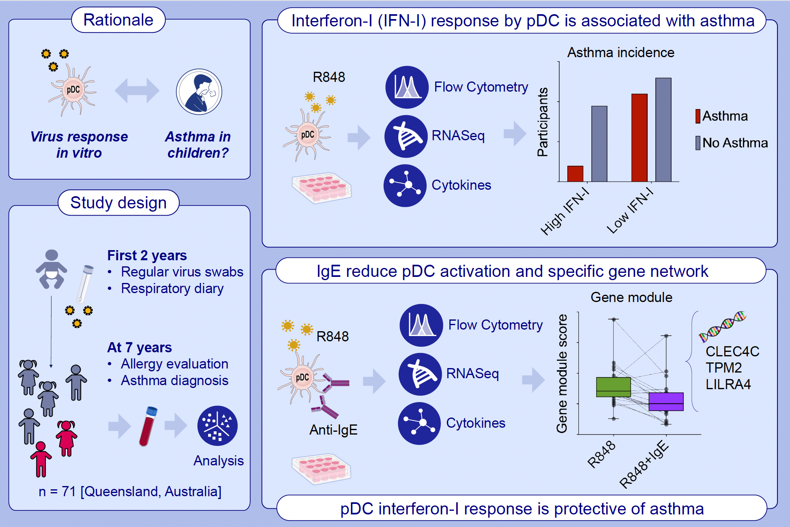
Reduced Type-I Interferon by Plasmacytoid Dendritic Cells and Asthma in School-Aged Children
Isabelle Coenen, Anya C. Jones, Alice A. White, Mari Takashima, Wen Ray Lee, et al.
Allergy. 2026; pages: 109-120
https://doi.org/10.1111/all.70005
© 2019 EAACI and John Wiley and Sons A/S. Published by John Wiley and Sons Ltd.
Notes:
HIGHLIGHTS
• Low type-I interferon response to in vitro stimulation of plasmacytoid dendritic cells (pDC) with a TLR7/8 agonist (R848) is associated with current asthma in school-aged children.
• Low type-I interferon response is associated with increased level of atopy but appears to have limited impact on early life viral infection susceptibility.
• IgE crosslinking reduces cell activation and downregulates a gene module consisting of genes that are associated with type I interferon regulation. .

