Slide 1
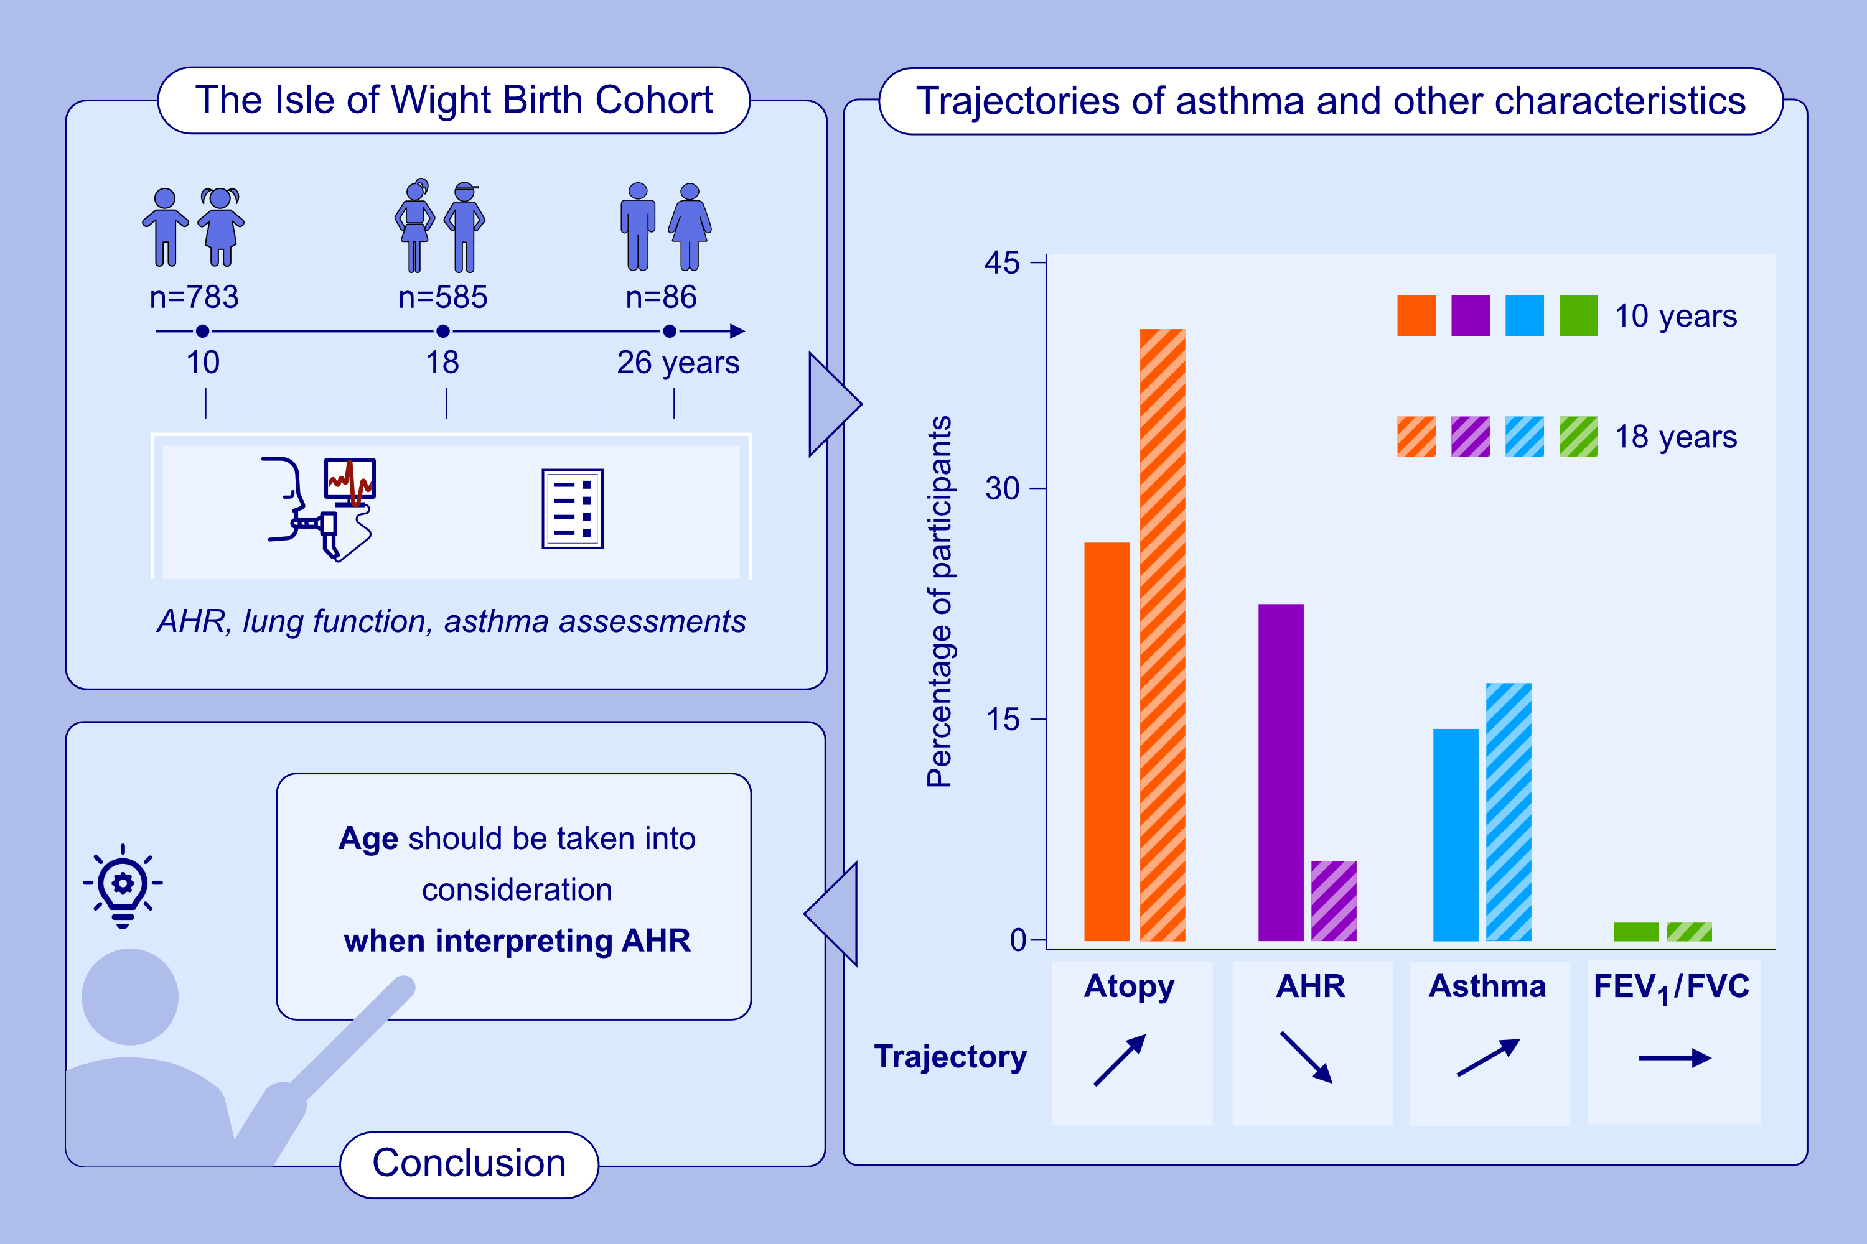
Natural History of Airway Hyperresponsiveness and Its Association With Asthma Traits
Sophie Carra, Hongmei Zhang, Ramesh J. Kurukulaaratchy, Syed Hasan Arshad
Allergy. 2026; pages: 121-129
https://doi.org/10.1111/all.70006
© 2019 EAACI and John Wiley and Sons A/S. Published by John Wiley and Sons Ltd.
Notes:
HIGHLIGHTS
• AHR improves in most children over adolescence when its relationship with asthma changes.
• AHR is better at ruling out asthma in children, while it is superior at ruling in asthma in young adults.
• Age should be considered when interpreting AHR and different cutoffs might be required for children and adults.
.

