Slide 1
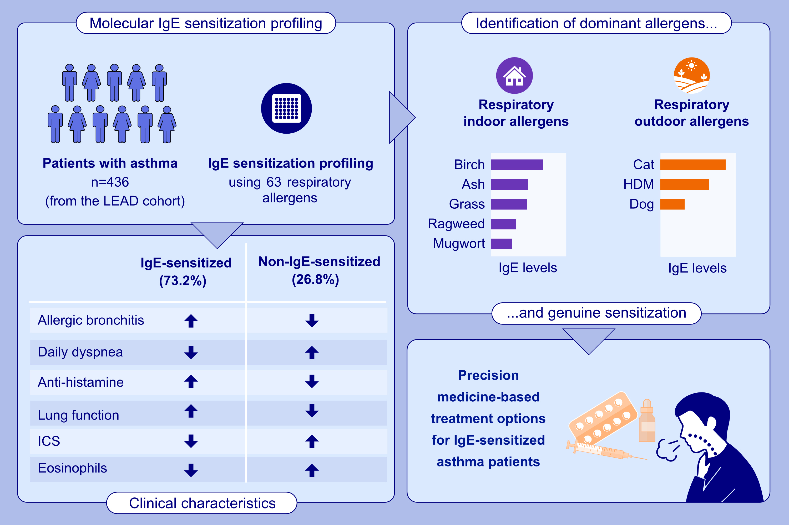
Molecular IgE Sensitization Profiling With Micro-Arrayed Allergen Molecules in Adult Patients With Asthma From the LEAD Cohort: A Precision Medicine Approach
Huey-Jy Huang, Robab Breyer-Kohansal, Katarzyna Niespodziana, Charmaine J. M. Lim, Marie-Kathrin Breyer, et al.
Allergy. 2026; pages: 130-144
https://doi.org/10.1111/all.70017
© 2019 EAACI and John Wiley and Sons A/S. Published by John Wiley and Sons Ltd.
Notes:
HIGHLIGHTS
• In the LEAD cohort, micro-arrayed asthma allergens identified IgE-sensitized adult asthma patients.
• Compared to non-IgE-sensitized patients, they had better lung function, took less ICS and had lower eosinophils.
• IgE-sensitized patients were sensitized to a handful of respiratory allergen sources and may benefit from allergen-specific forms of treatment such as AIT.
.

