Slide 1
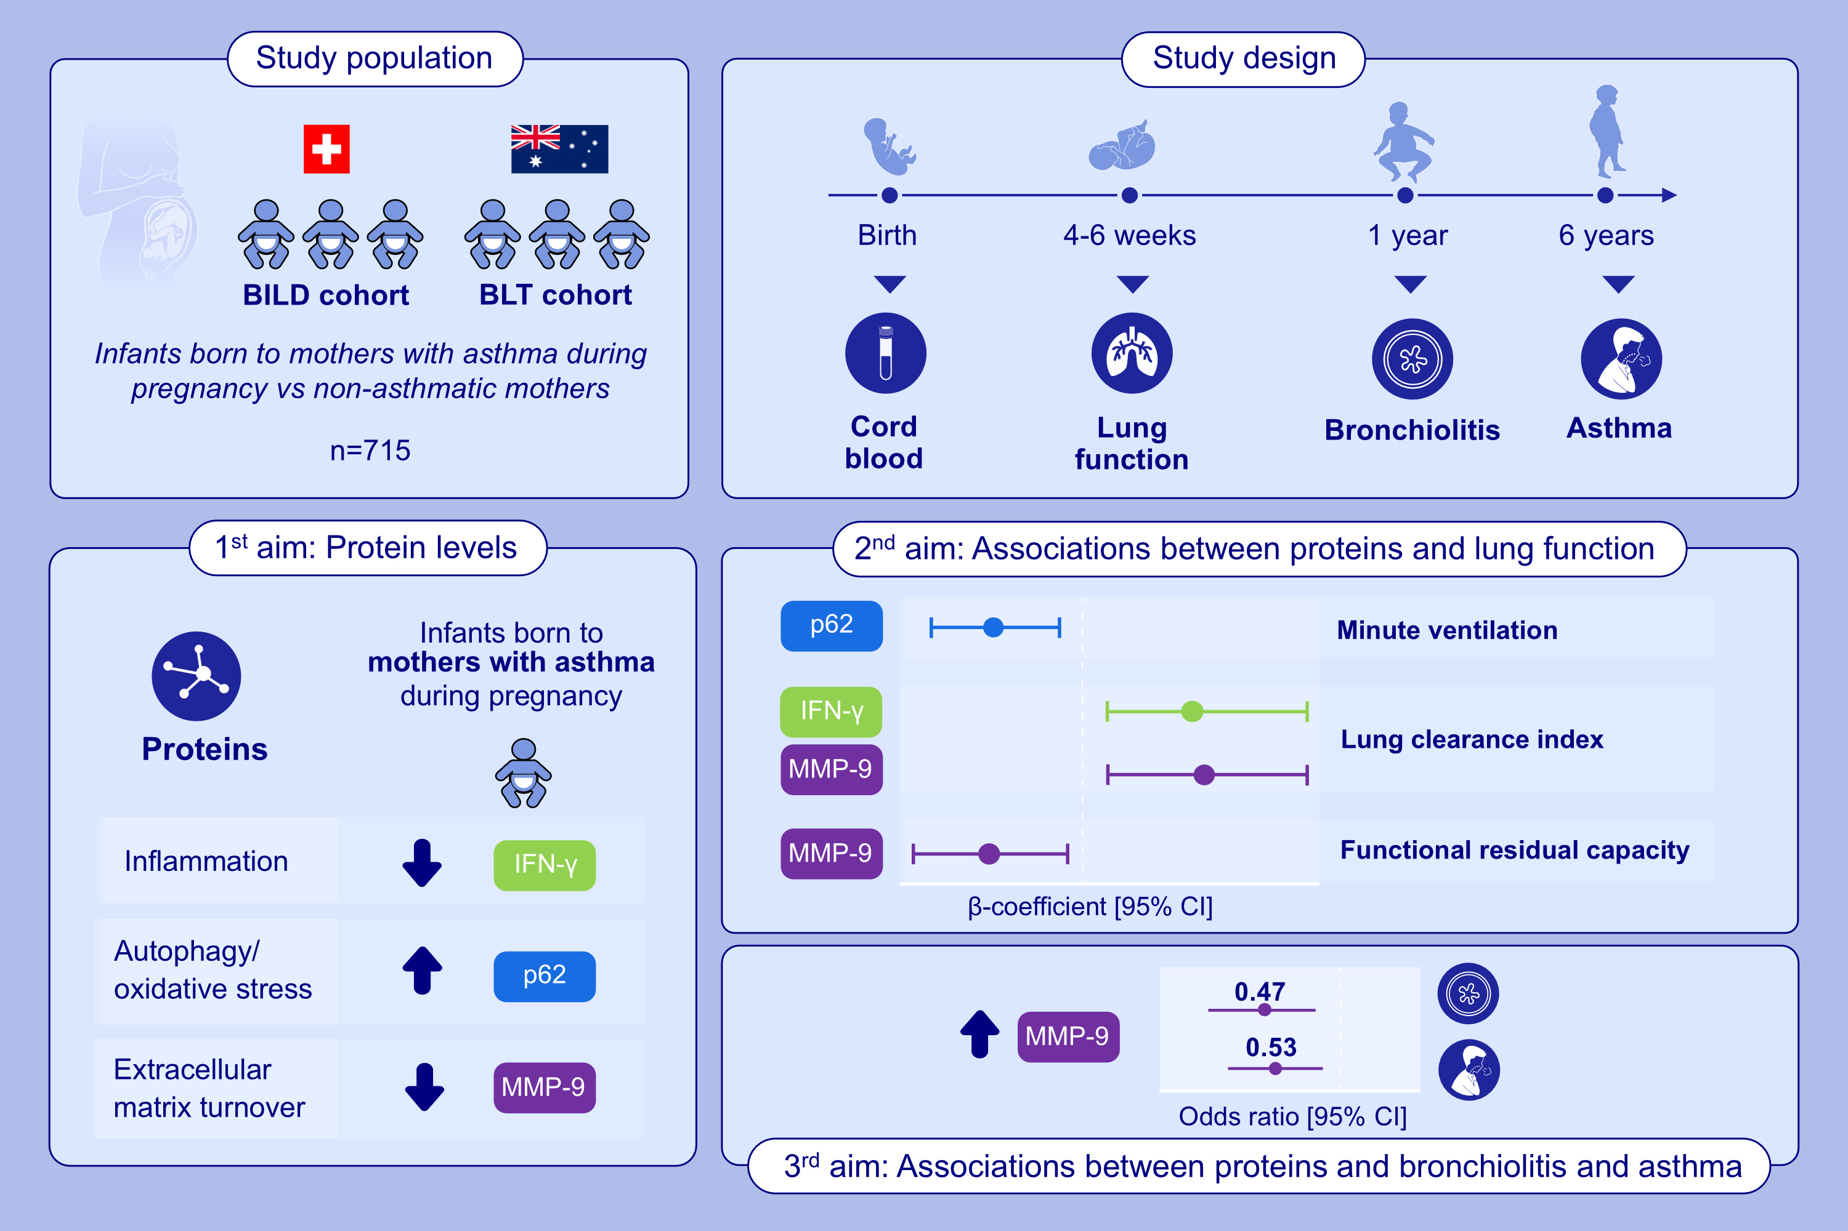
Markers in Infants of Mothers With Asthma and Associations With Respiratory Outcomes
Carla Rebeca Da Silva Sena, Gabriela Martins Costa Gomes, Noëmi Künstle, Olga Gorlanova, Andrea Marten, et al.
Allergy. 2026; pages: 145-156
https://doi.org/10.1111/all.70044
© 2019 EAACI and John Wiley and Sons A/S. Published by John Wiley and Sons Ltd.
Notes:
HIGHLIGHTS
• In the BILD and BLT cohorts, we compared cord blood proteins in infants of mothers with and without asthma during pregnancy.
• Groups showed different protein levels.
• These markers were associated with postnatal lung function, bronchiolitis hospitalization, and asthma.
• Additionally, p62 was inversely associated with minute ventilation, MMP-9 inversely with FRC and bronchiolitis/asthma risk, while IFN-γ and MMP-9 was positively associated with lung clearance index, highlighting distinct protein–lung function and disease associations. .

