Slide 1
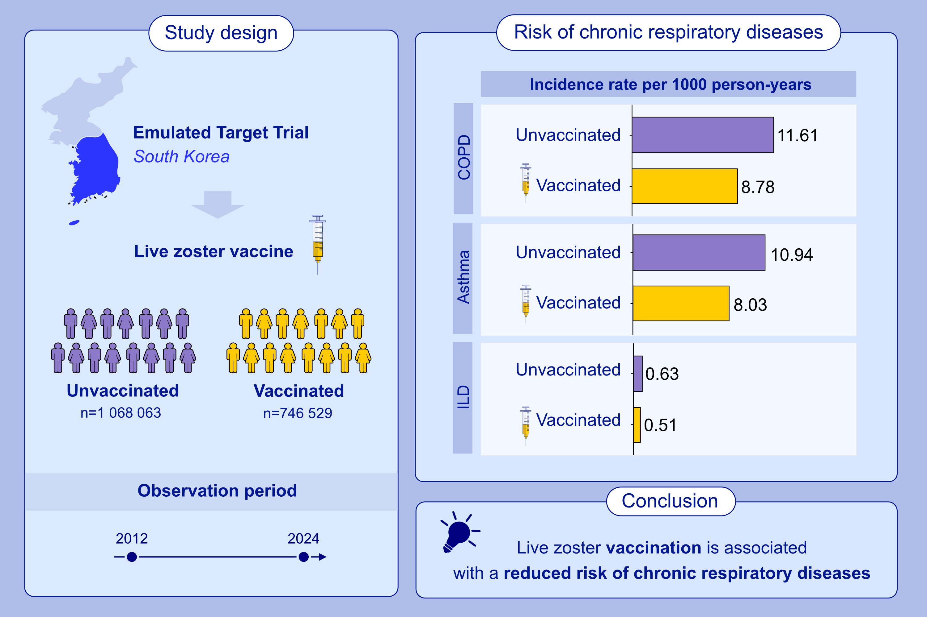
Live Zoster Vaccination and the Reduced Risk of Chronic Respiratory Diseases: An Emulated Target Trial
Tae Hyeon Kim, Kyeongmin Lee, Jaehyeong Cho, Jiyeon Oh, Sooji Lee, et al.
Allergy. 2026; pages: 209-219
https://doi.org/10.1111/all.70056
© 2019 EAACI and John Wiley and Sons A/S. Published by John Wiley and Sons Ltd.
Notes:
HIGHLIGHTS
• This emulated target trial investigated the risk of developing chronic respiratory diseases (COPD, asthma, and ILD) associated with live zoster vaccination using a nationwide, population-based cohort of individuals aged ≥50 years in South Korea.
• Live zoster vaccination significantly reduced the risk of COPD, asthma, and ILD, and reduced hospital admissions due to these conditions.
• These findings indicate additional public health benefits of live zoster vaccination beyond herpes zoster prevention.
•
.

