Slide 1
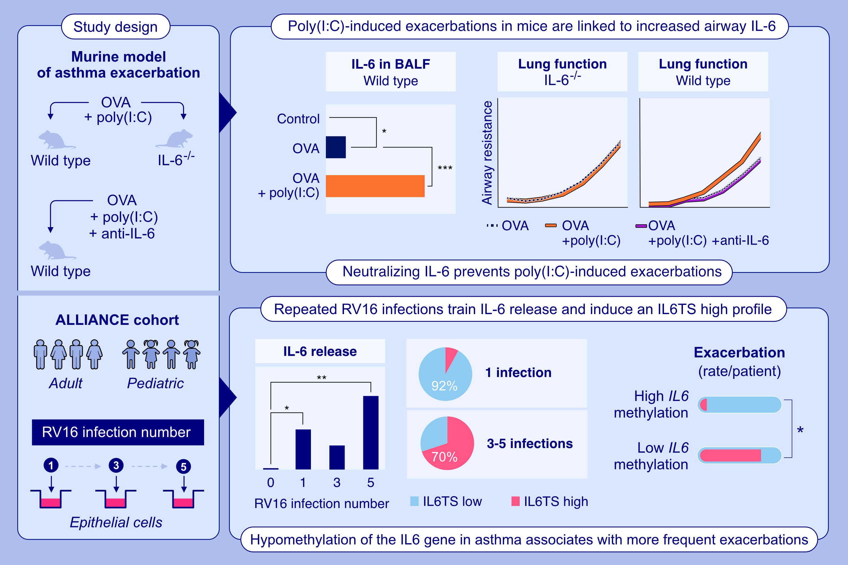
Immune Training of the Interleukin 6 Gene in Airway Epithelial Cells is Central to Asthma Exacerbations
Lars P. Lunding, Markus Weckmann, Ulrich M. Zissler, Constanze Jakwerth, Rebecca Bodenstein-Sgró, et al.
Allergy. 2026; pages: 157-169
https://doi.org/10.1111/all.70070
© 2019 EAACI and John Wiley and Sons A/S. Published by John Wiley and Sons Ltd.
Notes:
HIGHLIGHTS
• This study investigates how immune activation influences the epigenetic regulation and expression of the IL-6 gene during asthma exacerbations.
• Poly(I:C)-induced excessive IL-6 release, driven by training of innate immunity in the respiratory epithelium, is essential for the exacerbation of experimental asthma.
• Repeated RV16 or poly(I:C) exposure trained IL-6 release in human respiratory epithelial cells.
• Asthma patients with a trained IL-6 response, characterized by IL6 gene hypomethylation, exhibit more frequent exacerbations. .

