Slide 1
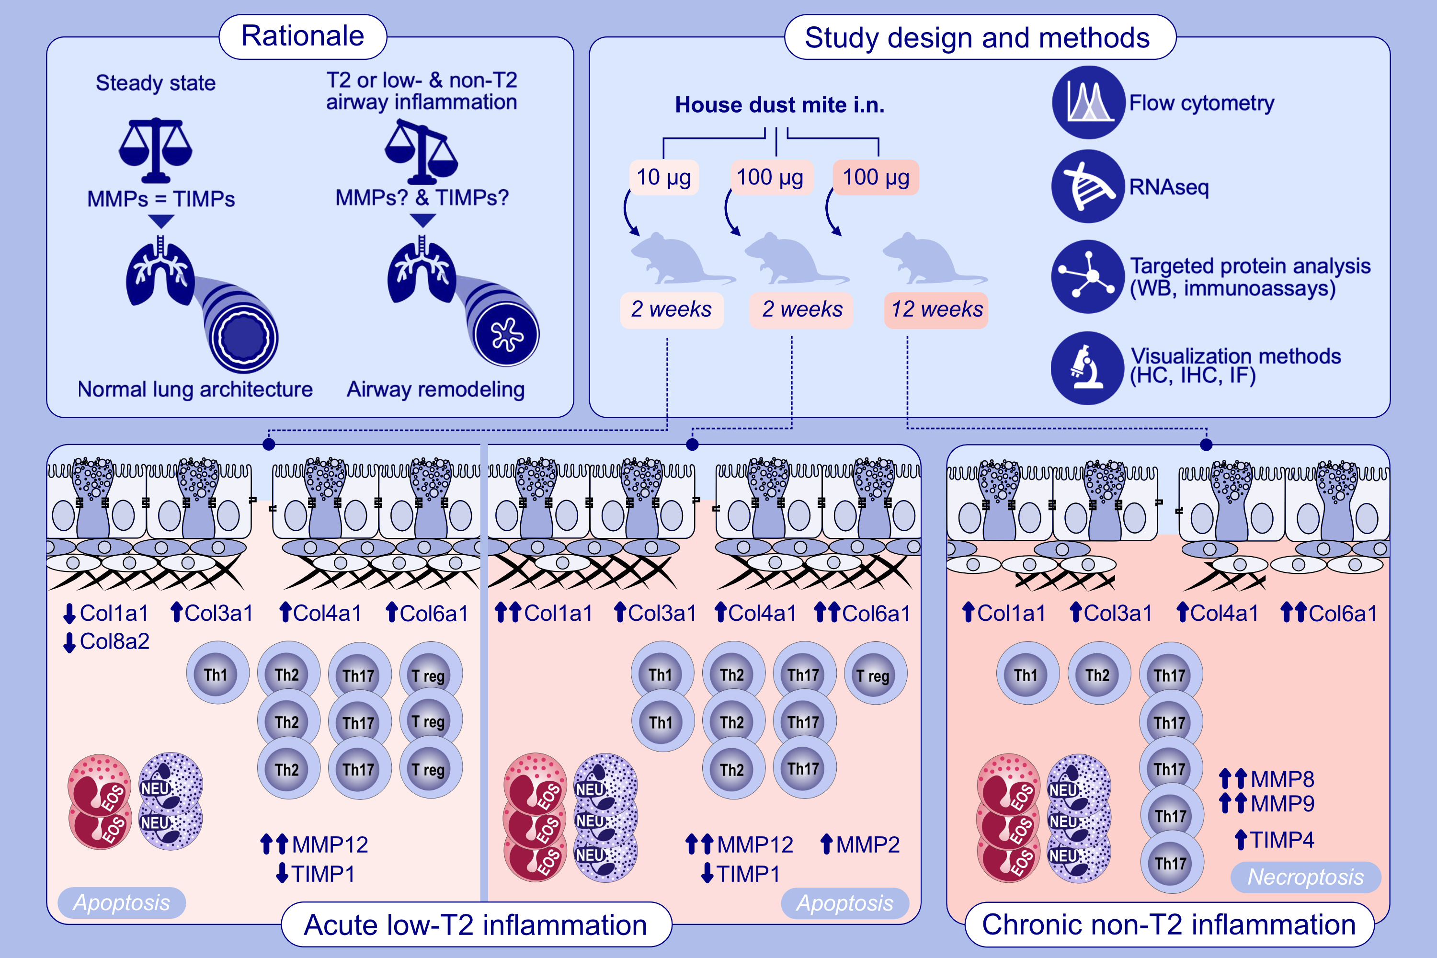
Dynamic Regulation of Collagens, Proteases, Their Inhibitors, and Cell Death in Experimental Asthma in Mice
Marlena Tynecka, Agnieszka Tarasik, Bartosz Hanczaruk, Adrian Janucik, Krystian Czolpinski, et al.
Allergy. 2026; pages: 170-184
https://doi.org/10.1111/all.70126
© 2019 EAACI and John Wiley and Sons A/S. Published by John Wiley and Sons Ltd.
Notes:
HIGHLIGHTS
• This study investigates airway remodeling in acute and chronic experimental asthma models induced by house dust mite extract to elucidate inflammatory and structural changes.
• Two acute T2-low models demonstrated pronounced airway inflammation characterized by goblet cell hyperplasia, collagen deposition, and significant upregulation of extracellular matrix remodeling and fibroblast activation.
• In contrast, the chronic Th17- mediated model exhibited reduced ECM deposition, increased matrix metalloproteinase activity, and a distinct molecular signature dominated by IL-17A-driven pathways, indicative of ECM degradation and structural instability.
.

