Slide 1
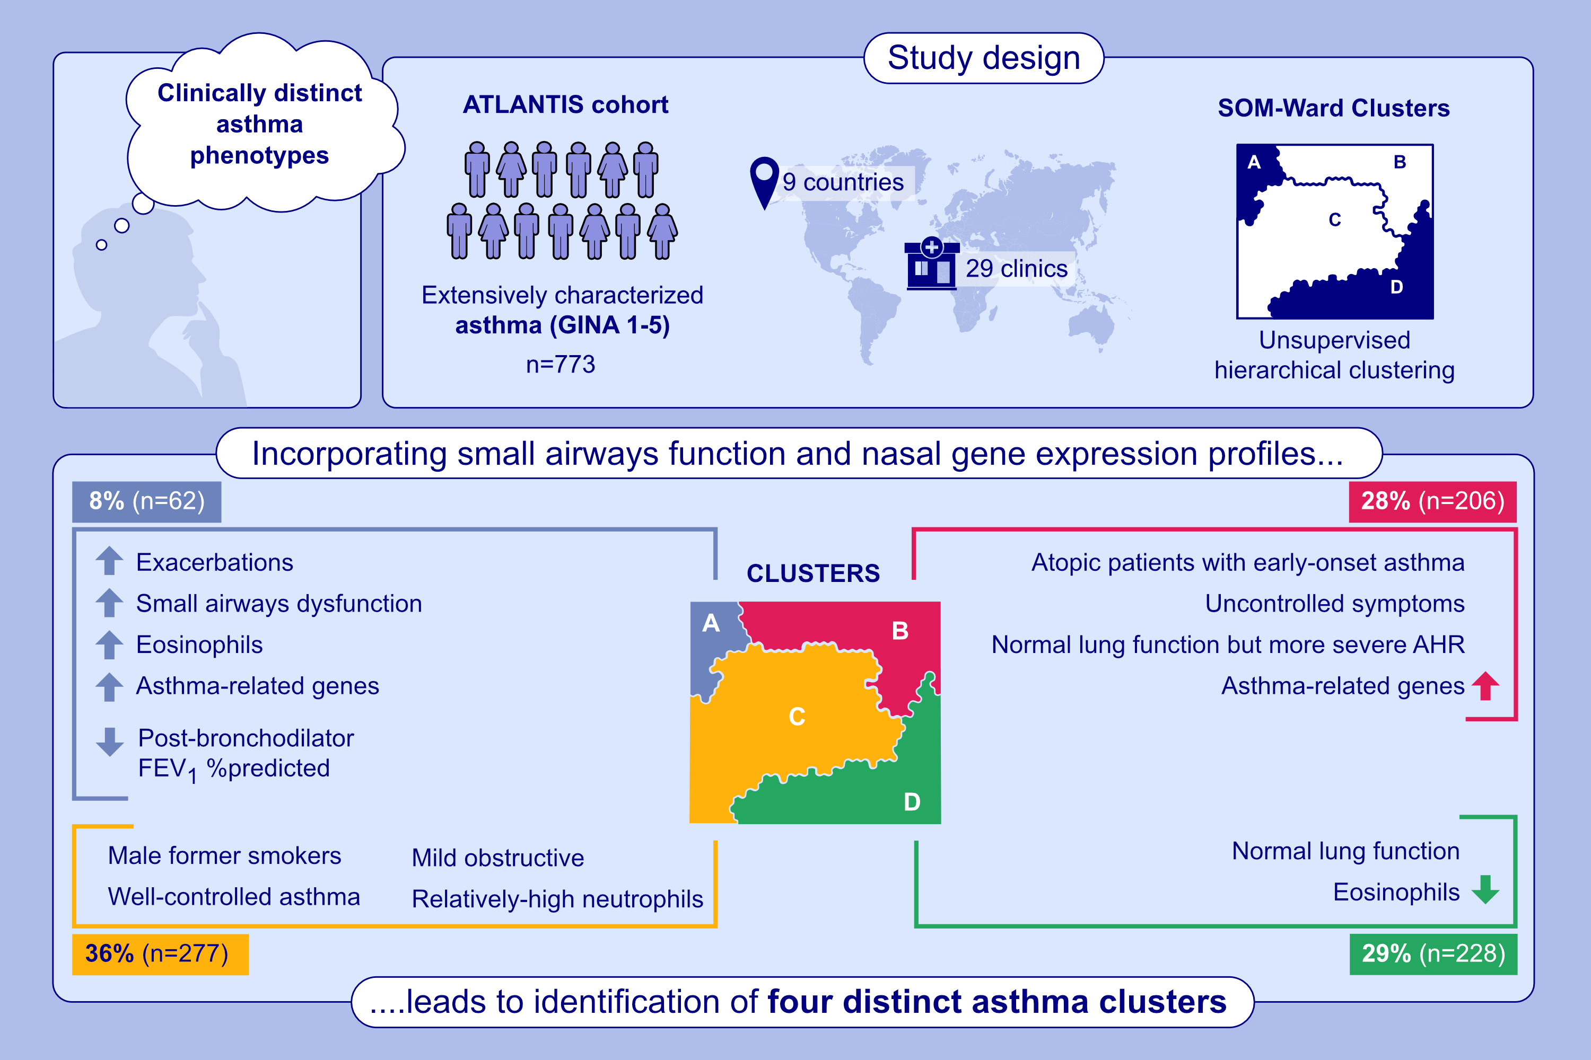
Cluster Analysis to Identify Distinct Asthma Phenotypes in the ATLANTIS Cohort
Pauline J. M. Kuks, Tatiana Karp, Jorine E. Hartman, Monica Kraft, Salman Siddiqui, et al.
Allergy. 2026; pages: 185-196
https://doi.org/10.1111/all.70127
© 2019 EAACI and John Wiley and Sons A/S. Published by John Wiley and Sons Ltd.
Notes:
HIGHLIGHTS
• This study identified four clinically distinct asthma clusters.
• The most severe cluster was characterized by type 2 inflammation and exhibited both large and small airways obstruction, as well as air trapping on CT.
• Patients in the earlier-onset cluster exhibited more severe bronchial hyperresponsiveness despite a relatively preserved lung function. .

