Slide 1
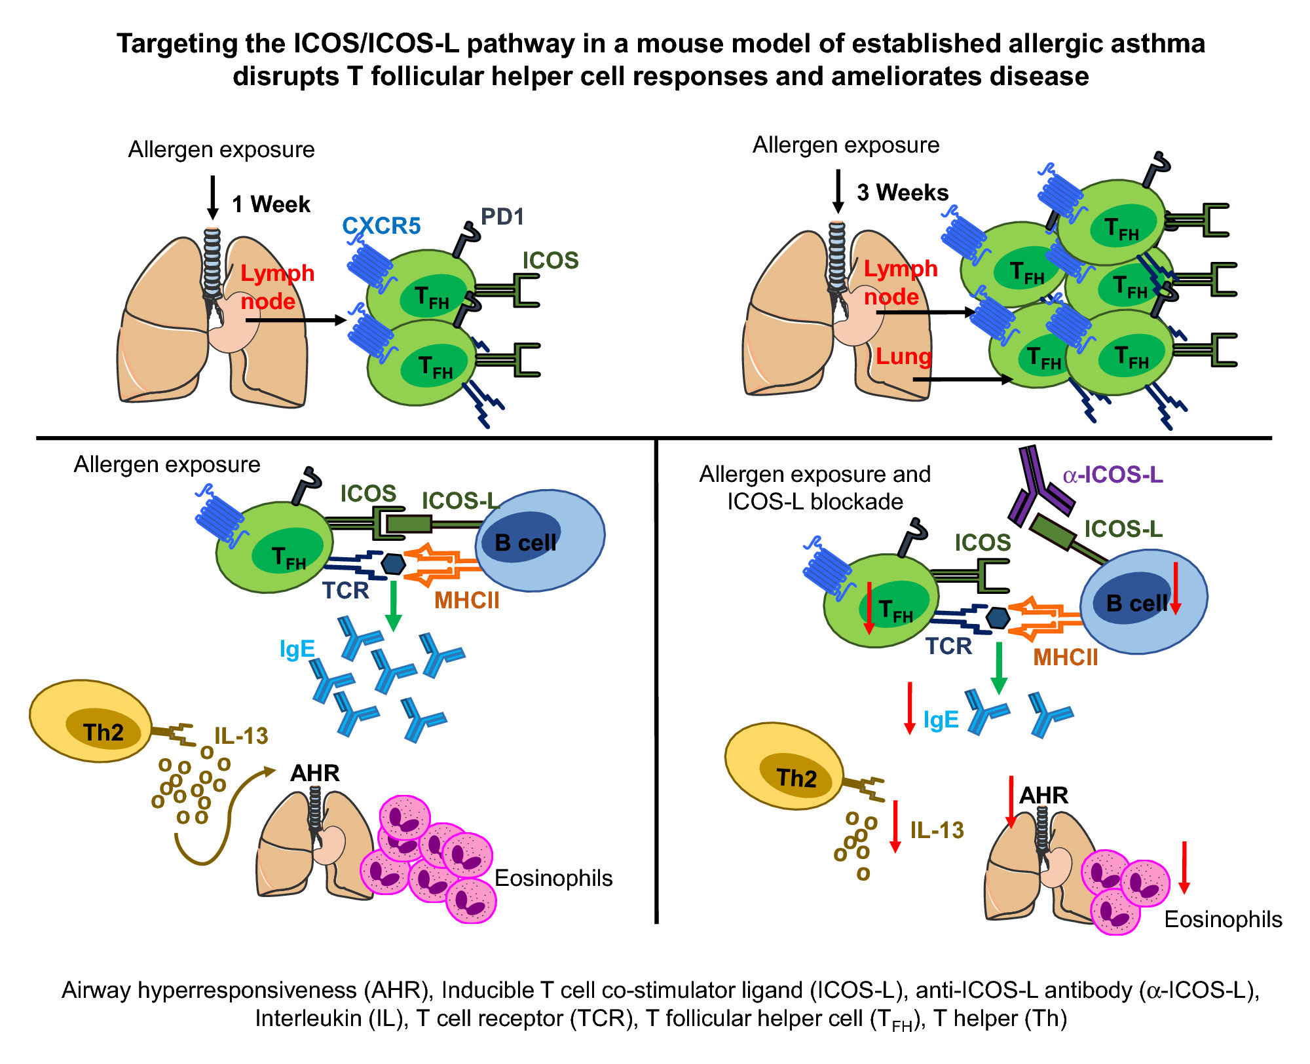
Targeting the ICOS/ICOS‐L pathway in a mouse model of established allergic asthma disrupts T follicular helper cell responses and ameliorates disease
Faith I. Uwadiae, Chloe J. Pyle, Simone A. Walker, Clare M. Lloyd, James A. Harker, et al.
Allergy. 2019; 650-662 https://doi.org/10.1111/all.13602
© 2019 EAACI and John Wiley and Sons A/S. Published by John Wiley and Sons Ltd.
Notes:
HIGHLIGHTS
• The upper airway microbiome was different between young adults and elderly, and their association with asthma was also different.
• The microbiome genes reducing airway inflammation and degrading air pollutants were lower in asthmatics, whereas genes enhancing inflammation and mucosal bacterial colonization were higher in asthmatics of young adults.
• The composition and function of upper airway microbiome could influence asthma pathogenesis, and the microbiome could play various roles depending on the age group.
ABBREVIATIONS
Keywords:

