Slide 1
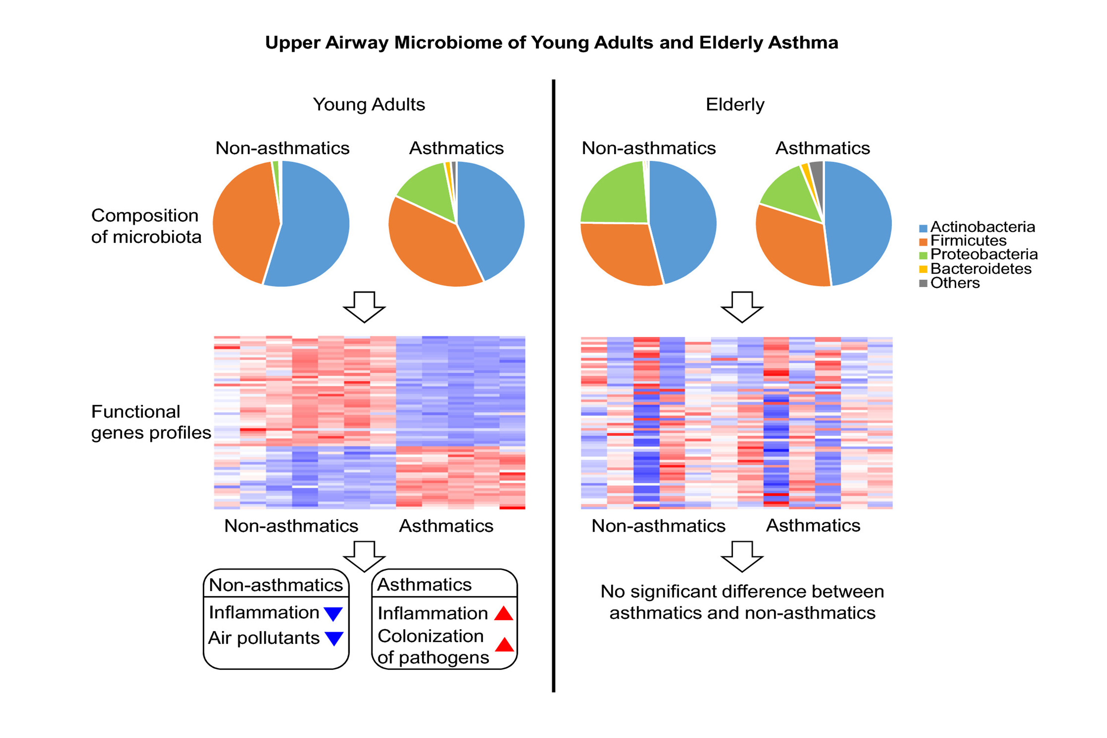
Different upper airway microbiome and their functional genes associated with asthma in young adults and elderly individuals
Jin‐Jae Lee, Sae‐Hoon Kim, Min‐Jung Lee, Byung‐Keun Kim, Woo‐Jung Song, et al.
Allergy. 2019; 709-719 https://doi.org/10.1111/all.13608
© 2019 EAACI and John Wiley and Sons A/S. Published by John Wiley and Sons Ltd.
Notes:
HIGHLIGHTS
• The upper airway microbiome was different between young adults and elderly, and their association with asthma was also different.
• The microbiome genes reducing airway inflammation and degrading air pollutants were lower in asthmatics, whereas genes enhancing inflammation and mucosal bacterial colonization were higher in asthmatics of young adults.
• The composition and function of upper airway microbiome could influence asthma pathogenesis, and the microbiome could play various roles depending on the age group.
ABBREVIATIONS
Keywords:

