Slide 1
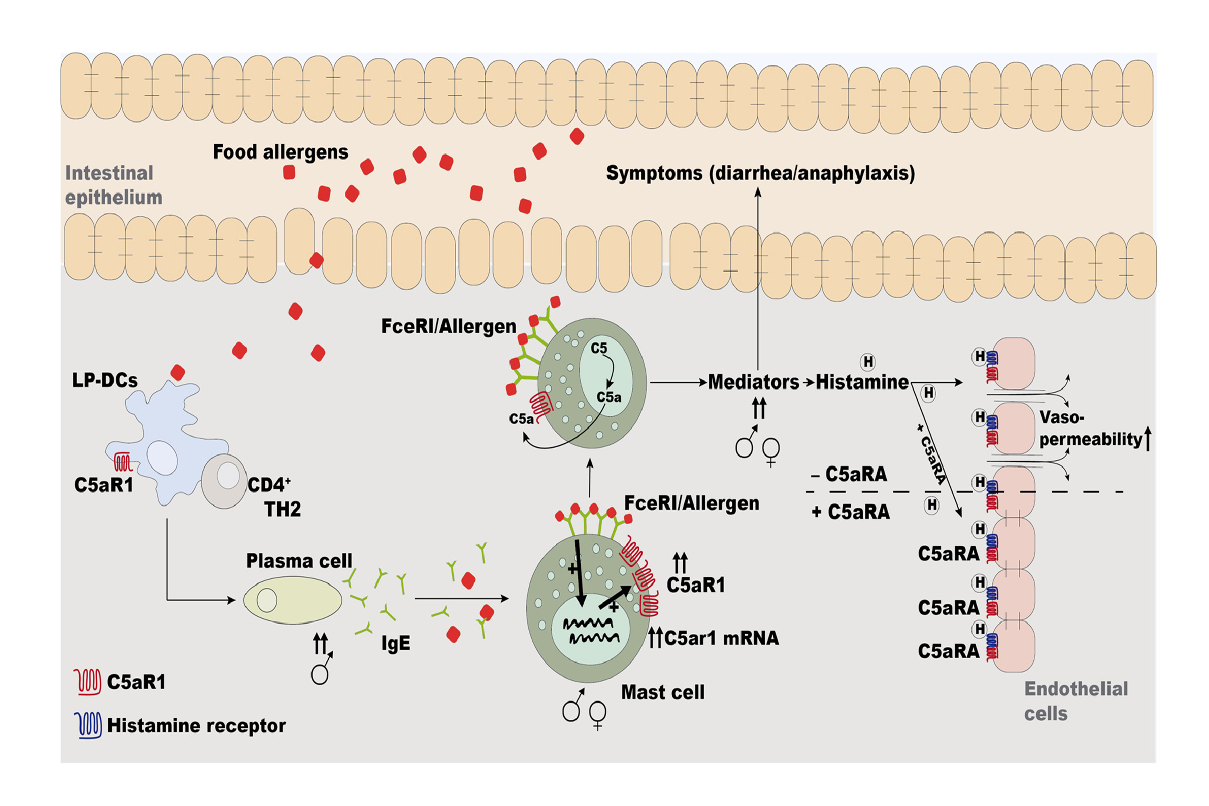
C5a receptor 1−/− mice are protected from the development of IgE‐mediated experimental food allergy
Anna Kordowski, Anna T. Reinicke, David Wu, Zane Orinska, Philipp Hagemann, et al.
Allergy. 2019; 767-779 https://doi.org/10.1111/all.13637
© 2019 EAACI and John Wiley and Sons A/S. Published by John Wiley and Sons Ltd.
Notes:
HIGHLIGHTS
• The C5a/C5aR1 axis controls the production of allergen‐specific IgE in male mice.
• FcεR1 aggregation upregulates C5aR1 expression in mast cells which amplifies IgE‐driven mediator release.
• C5aR1 signaling controls histamine‐mediated effector functions in vivo and in vitro.
ABBREVIATIONS
Keywords:

