Slide 1
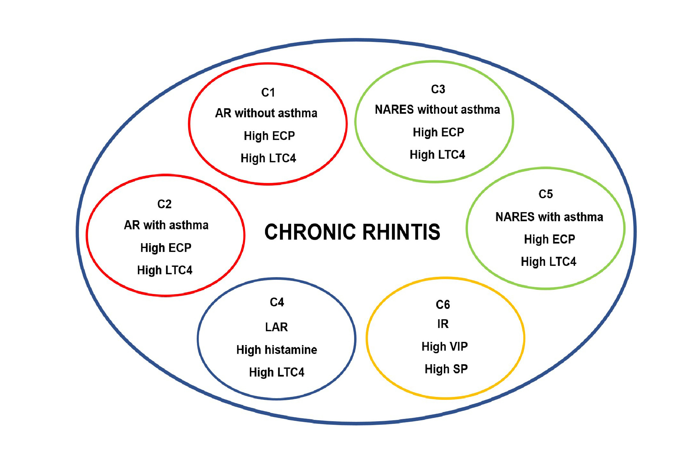
Endotypes of chronic rhinitis: A cluster analysis study
Yifan Meng, Hongfei Lou, Yang Wang, Xiaoyan Wang, Feifei Cao, et al.
Allergy. 2019; 720-730 https://doi.org/10.1111/all.13640
© 2019 EAACI and John Wiley and Sons A/S. Published by John Wiley and Sons Ltd.
Notes:
HIGHLIGHTS
• Chinese CR patients could be clustered into six endotype clusters, including: (1) Allergic rhinitis without asthma; (2) Allergic rhinitis with asthma; (3) nonallergic rhinitis with eosinophilia syndrome (NARES) without asthma; (4) local allergic rhinitis; (5) NARES with asthma; (6) idiopathic rhinitis.
• Clusters 1, 2, 3 and 5 demonstrated significantly higher levels of eosinophil cationic protein and leukotriene C4 (LTC4); whereas cluster 4 demonstrated significantly higher levels of histamine and LTC4. Similarly, Cluster 6 demonstrated significantly higher levels of vasoactive intestinal peptide and substance P.
ABBREVIATIONS
Keywords:

