Slide 1
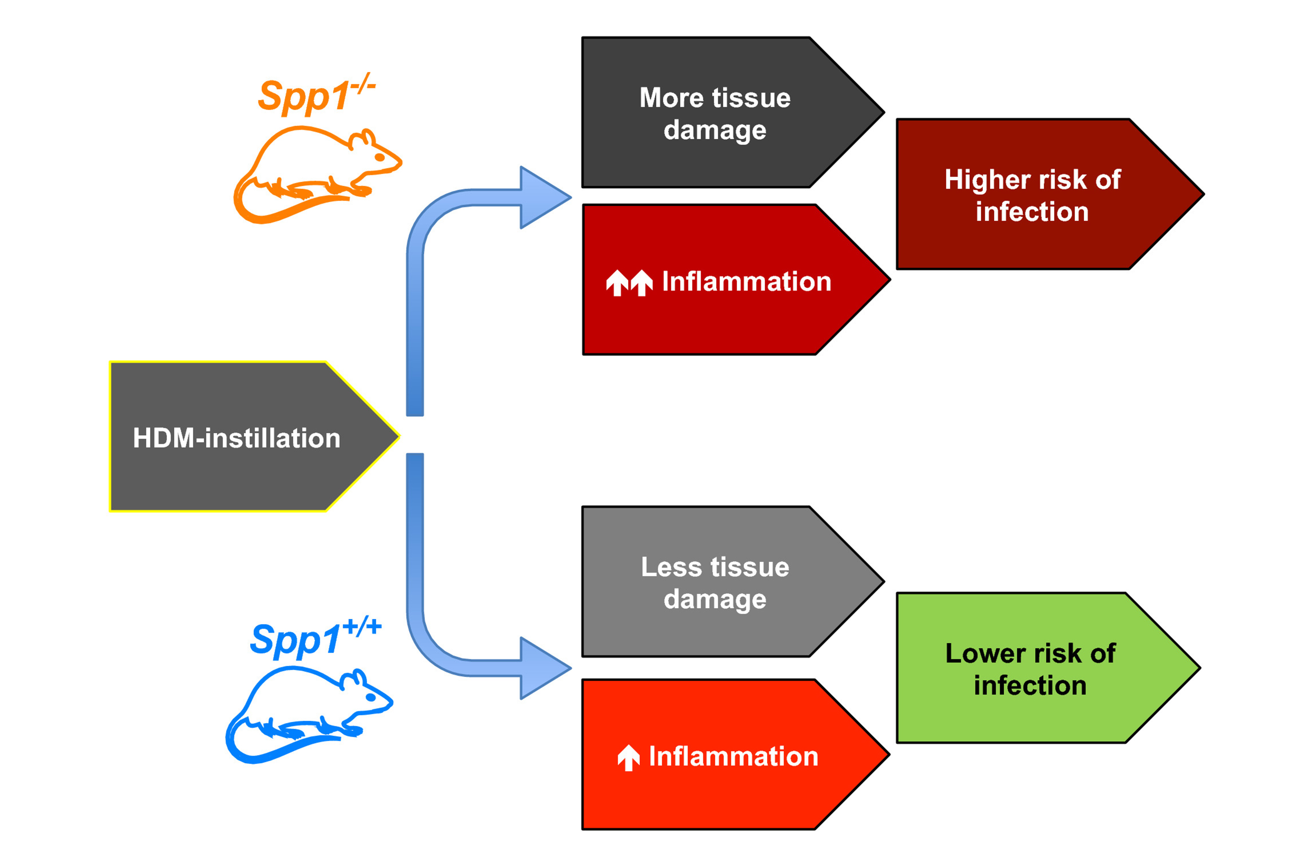
Osteopontin protects against pneumococcal infection in a murine model of allergic airway inflammation
Gopinath Kasetty, Ravi K. V. Bhongir, Praveen Papareddy, Ellen Tufvesson, Henning Stenberg, et al.
Allergy. 2019; 663-674 https://doi.org/10.1111/all.13646
© 2019 EAACI and John Wiley and Sons A/S. Published by John Wiley and Sons Ltd.
Notes:
HIGHLIGHTS
• HDM-instillation to the airways causes increased inflammation and tissue damage in osteopontin-deficient mice.
• Osteopontin-deficient mice (Spp1-/-) with an ongoing allergic airway inflammation are more prone to pneumococcal infection.
• The findings suggest that osteopontin plays important roles, modulating inflammation, tissue damage, and host defense against pneumococcal infection during allergic asthma.
ABBREVIATIONS
Keywords:

