Slide 1
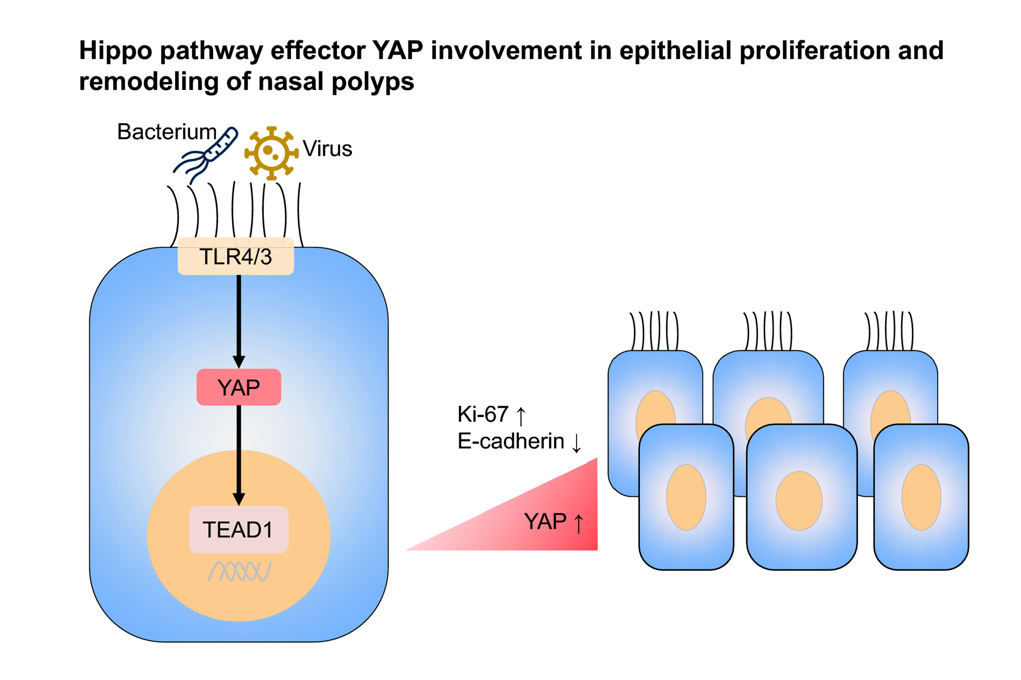
The hippo pathway effector Yes‐associated protein promotes epithelial proliferation and remodeling in chronic rhinosinusitis with nasal polyps
Huiyi Deng, Yueqi Sun, Weihao Wang, Meijiao Li, Tian Yuan, et al.
Allergy. 2019; 731-742 https://doi.org/10.1111/all.13647
© 2019 EAACI and John Wiley and Sons A/S. Published by John Wiley and Sons Ltd.
Notes:
HIGHLIGHTS
• Hippo pathway is aberrantly expressed in nasal polyps.
• Hippo pathway effector YAP is involved in epithelial proliferation and remodelling in nasal polyps.
• Inhibition of YAP can reduce proliferation of nasal polyp epithelial cells.
ABBREVIATIONS
Keywords:

