Slide 1
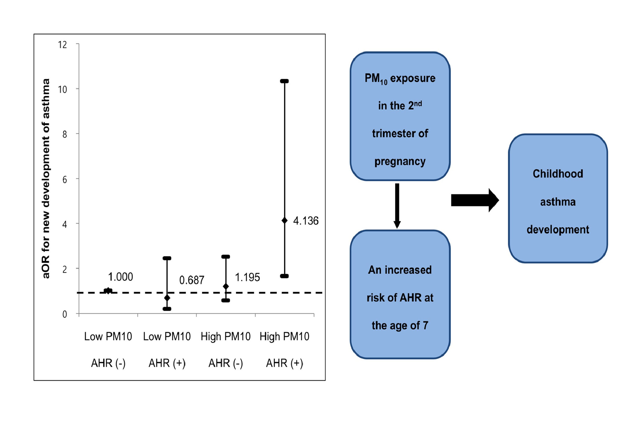
Prenatal particulate matter affects new asthma via airway hyperresponsiveness in schoolchildren
Song‐I Yang, So‐Yeon Lee, Hyo‐Bin Kim, Hwan‐Cheol Kim, Jong‐Han Leem, et al.
Allergy. 2019; 675-684 https://doi.org/10.1111/all.13649
© 2019 EAACI and John Wiley and Sons A/S. Published by John Wiley and Sons Ltd.
Notes:
HIGHLIGHTS
• Higher PM₁₀* exposure in the second trimester and AHR# at 7 years showed combined effect on the new diagnosis of asthma at school age (aOR 4.136).
• PM₁₀* exposure in the second trimester may affect the development of childhood asthma via AHR#.
ABBREVIATIONS
Keywords:

