Slide 1
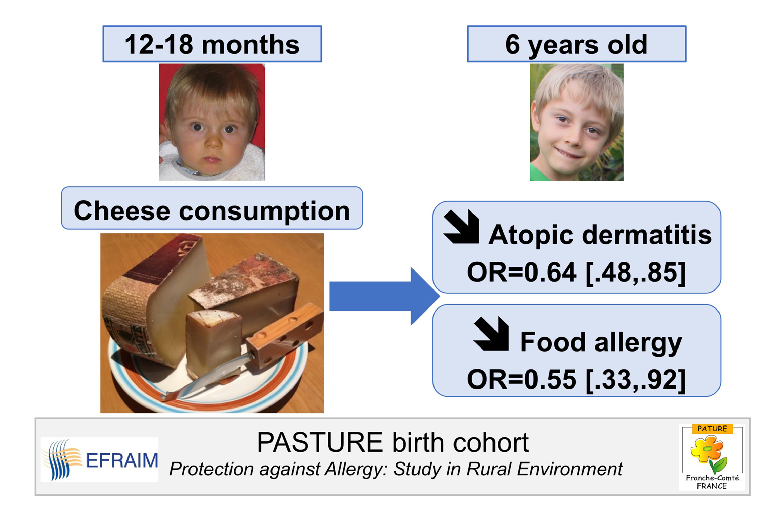
The protective effect of cheese consumption at 18 months on allergic diseases in the first 6 years
Sophie Nicklaus, Amandine Divaret‐Chauveau, Marie‐Laure Chardon, Caroline Roduit, Vincent Kaulek, et al.
Allergy. 2019; 788-798 https://doi.org/10.1111/all.13650
© 2019 EAACI and John Wiley and Sons A/S. Published by John Wiley and Sons Ltd.
Notes:
HIGHLIGHTS
• Data from the Pasture cohort were used to evaluate the effect of cheese consumption at 18 months of age against allergic diseases up to 6 years of age.
• Multivariate analyses adjusted for major confounders showed a protective effect of cheese consumption and variety against atopic dermatitis and food allergy, but not on allergic rhinitis, asthma, and sensitization to allergens. Reverse causality cannot be totally ruled out but is unlikely.
ABBREVIATIONS
Keywords:

