Slide 1
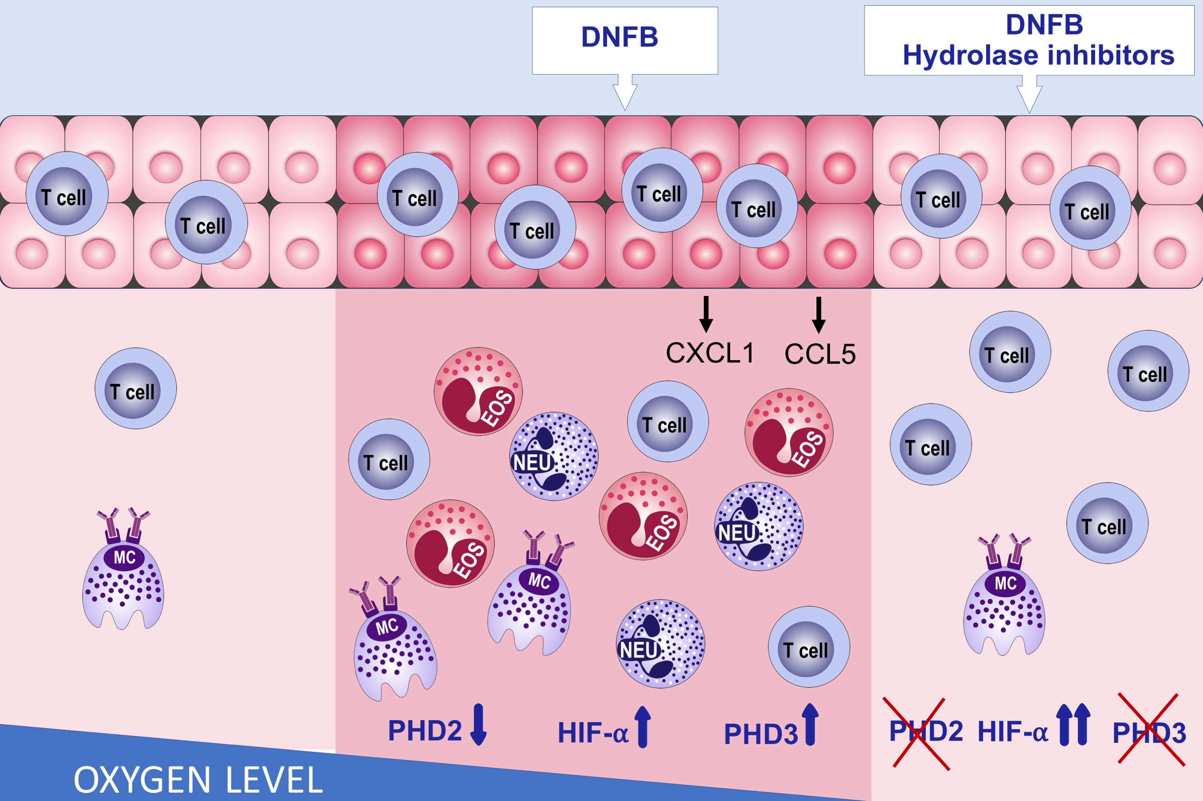
Pharmacologic inhibition of hypoxia‐inducible factor (HIF)‐hydroxylases ameliorates allergic contact dermatitis
Mario C. Manresa, Leila Smith, Laura Casals‐Diaz, Raphael R. Fagundes, Eric Brown, et al.
Allergy. 2019; 753-766 https://doi.org/10.1111/all.13655
© 2019 EAACI and John Wiley and Sons A/S. Published by John Wiley and Sons Ltd.
Notes:
HIGHLIGHTS
• Pharmacologic inhibition of HIF-hydroxylases, which mimics hypoxia, reduces inflammation in a mouse model of acute contact dermatitis.
• HIF hydroxylase inhibition reduces inflammatory chemokine production by keratinocytes.
• Topical application of HIF-hydroxylase inhibitors may be an effective approach for the treatment of T-cell driven allergic skin inflammation.
ABBREVIATIONS
Keywords:

