Slide 1
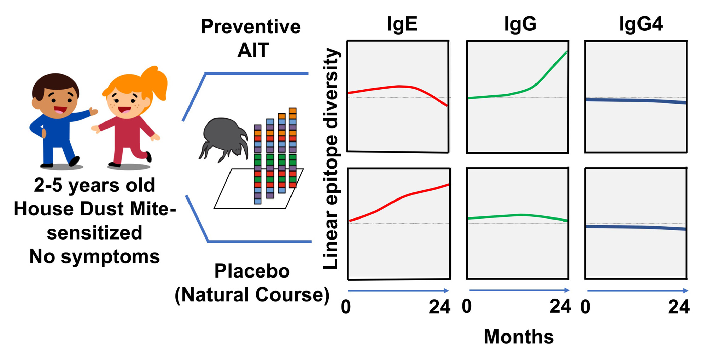
Preventive sublingual immunotherapy with House Dust Mite extract modulates epitope diversity in pre‐school children
Marta Ponce, Fabian Schroeder, Christina Bannert, Klara Schmidthaler, Christian Skjødt Hansen, et al.
Allergy. 2019; 780-787 https://doi.org/10.1111/all.13658
© 2019 EAACI and John Wiley and Sons A/S. Published by John Wiley and Sons Ltd.
Notes:
HIGHLIGHTS
Preventive sublingual immunotherapy with house dust mite (HDM) extract increases IgG antibody diversity.
It prevents IgE repertoire expansion to HDM proteins in pre‐school children.
IgG‐IgE overlap suggestive for an increase in blocking antibodies diversity takes place during pAIT.

