Slide 1
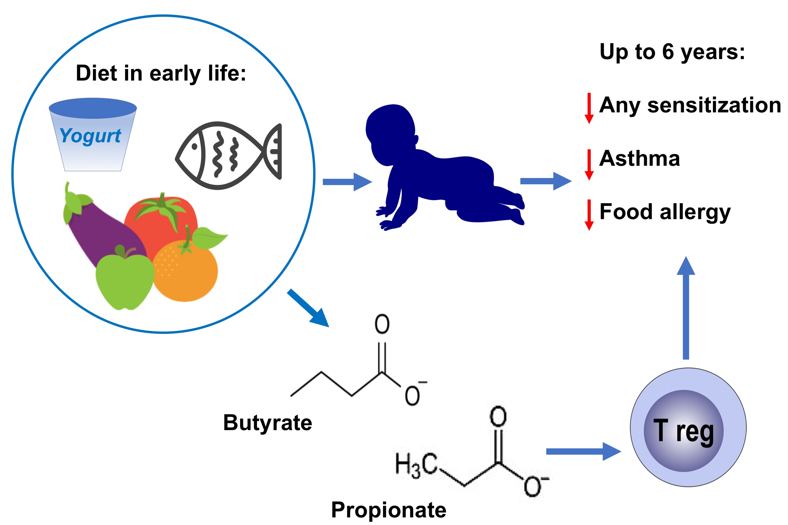
High levels of butyrate and propionate in early life are associated with protection against atopy
Caroline Roduit, Remo Frei, Ruth Ferstl, Susanne Loeliger, Patrick Westermann, et al.
Allergy. 2019; 799-809 https://doi.org/10.1111/all.13660
© 2019 EAACI and John Wiley and Sons A/S. Published by John Wiley and Sons Ltd.
Notes:
HIGHLIGHTS
• Children with high levels of butyrate or propionate in feces atone year of age have significantly less atopic sensitization com-pared to children with lower levels.
• The infant's diet might influence the levels of SCFAs.
• Oral application of short-chain fatty acids might protect children against the development of atopic sensitization and airway inflammation.
ABBREVIATIONS
Keywords:

