Slide 1
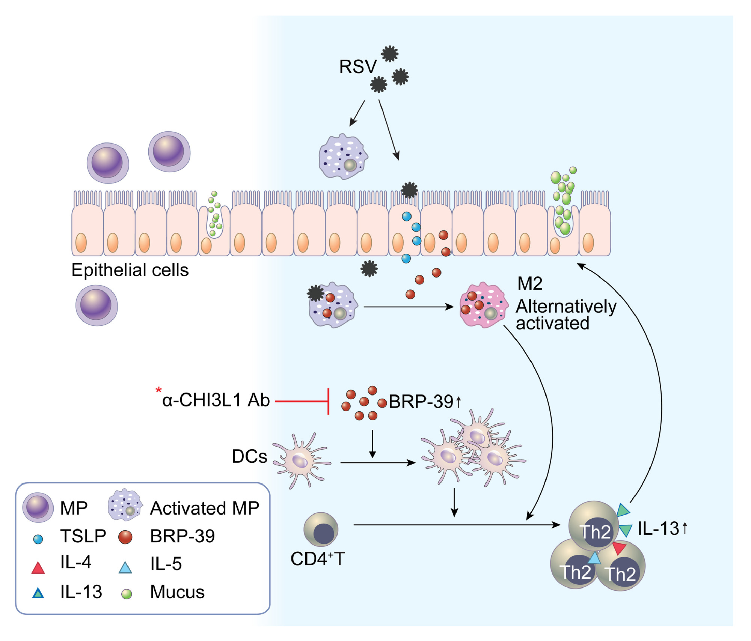
Chitinase 3‐like 1 protein plays a critical role in respiratory syncytial virus‐induced airway inflammation
Min Jung Kim, Doo Hee Shim, Hye‐Ran Cha, Kuk‐Young Moon, Chang Mo Yang, et al.
Allergy. 2019; 685-697 https://doi.org/10.1111/all.13661
© 2019 EAACI and John Wiley and Sons A/S. Published by John Wiley and Sons Ltd.
Notes:
HIGHLIGHTS
• Respiratory syncytial virus infection induces increased expression of BRP-39 by macrophages and epithelial cells that is related to Th2 inflammation.
• A lack of BRP-39 attenuates RSV-induced airway inflammation and IL-13 responses.
• BRP-39 is an important regulator of RSV infection and suggested as a potential therapeutic target for RSV-related respiratory illness.
ABBREVIATIONS
Keywords:

