Slide 1
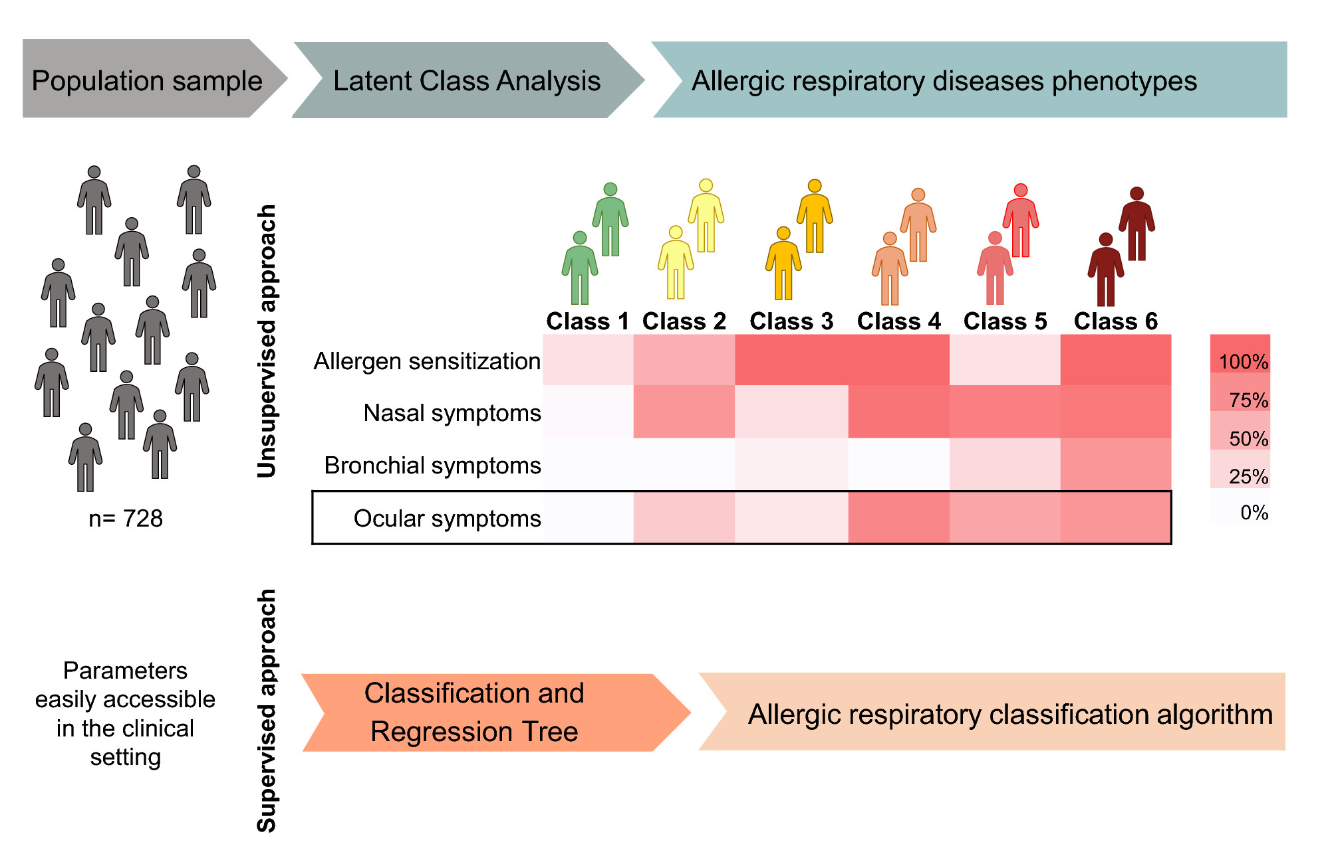
Disentangling the heterogeneity of allergic respiratory diseases by latent class analysis reveals novel phenotypes
Rita Amaral, Jean Bousquet, Ana M. Pereira, Luís M. Araújo, Ana Sá‐Sousa, et al.
Allergy. 2019; 698-708 https://doi.org/10.1111/all.13670
© 2019 EAACI and John Wiley and Sons A/S. Published by John Wiley and Sons Ltd.
Notes:
HIGHLIGHTS
• Novel phenotypes of allergic respiratory diseases were identified by latent class analysis, in adults from a general population sample.
• A classification tree algorithm was generated using easily accessible parameters available in the clinical setting.
• For the first time, ocular symptoms were used independently and ranked by classification and regression tree analysis as the most relevant variable to separate those phenotypes.
ABBREVIATIONS
Keywords:

