Slide 1
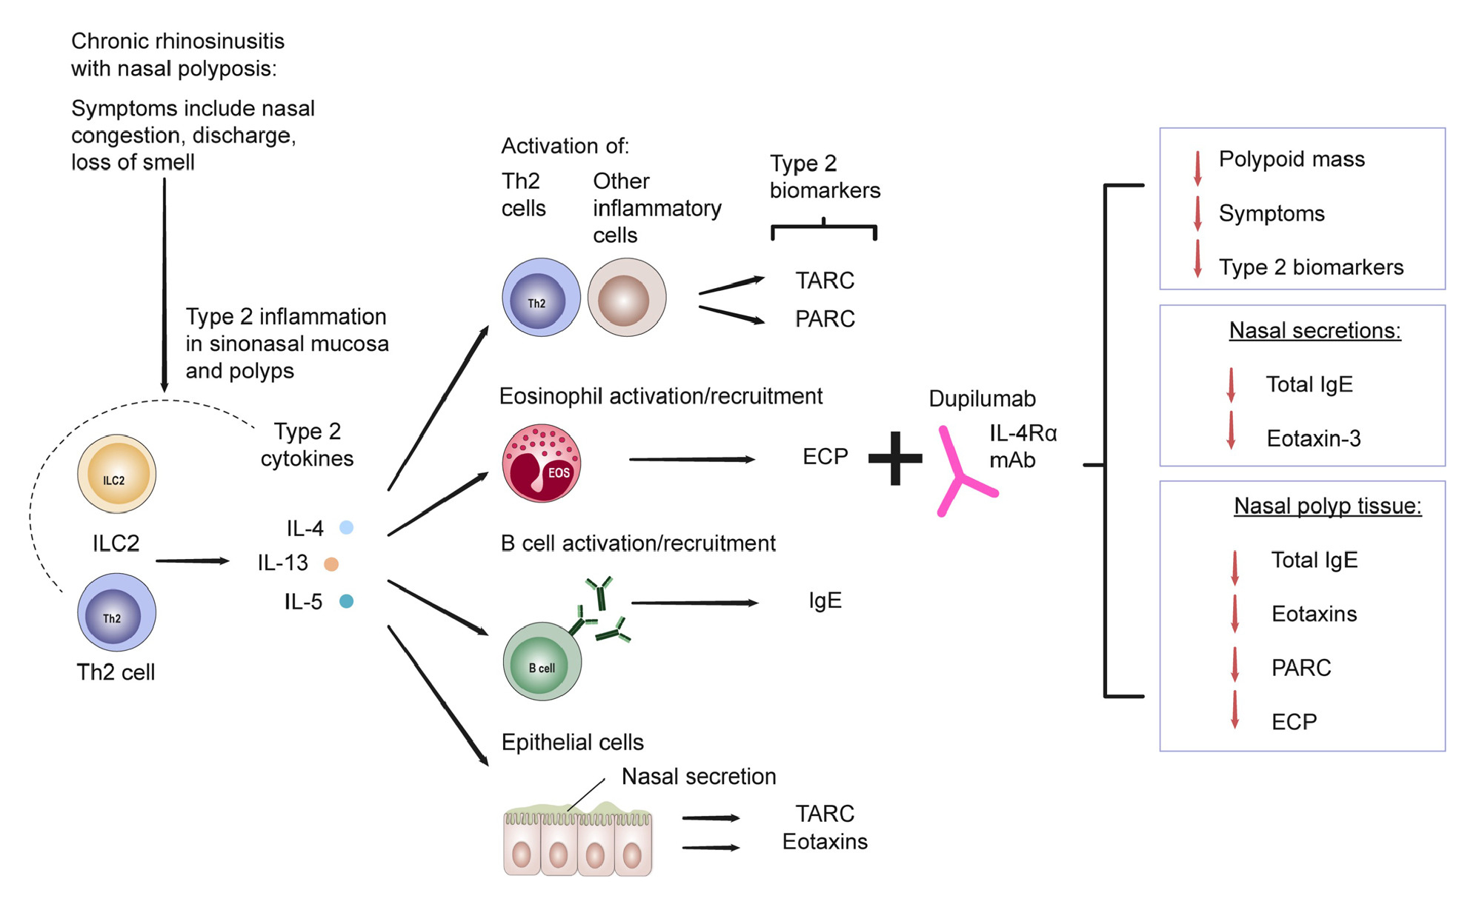
Dupilumab reduces local type 2 pro‐inflammatory biomarkers in chronic rhinosinusitis with nasal polyposis
Karin Jonstam, Brian N. Swanson, Leda P. Mannent, Lars‐Olaf Cardell, Nian Tian, et al.
Allergy. 2019; 743-752 https://doi.org/10.1111/all.13685
© 2019 EAACI and John Wiley and Sons A/S. Published by John Wiley and Sons Ltd.
Notes:
HIGHLIGHTS
• Dupilumab reduced multiple type 2 inflammation biomarkers in nasal secretions and polyp tissues of patients with chronic rhinosinusitis with nasal polyposis, including total IgE and chemoattractants for inflammatory cells.
• Local reductions in type 2 biomarkers were consistent with overall, parallel improvements in nasosinal symptoms and reductions in polypoid tissue.
• These findings suggest that inhibition of IL-4/IL-13 signaling via dupilumab‐mediated blockade of IL‐4Rα can suppress underlying inflammation of nasal polyposis, leading to clinical benefits.
ABBREVIATIONS
Keywords:

