Slide 1
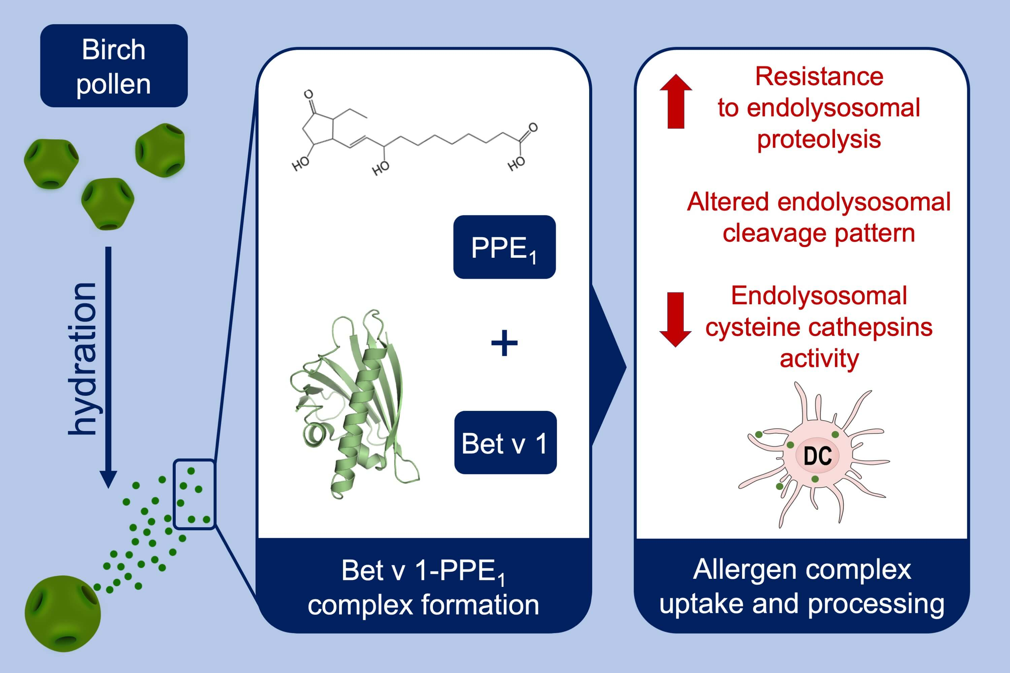
Multiple roles of Bet v 1 ligands in allergen stabilization and modulation of endosomal protease activity
Wai Tuck Soh, Lorenz Aglas, Geoffrey A. Mueller, Stefanie Gilles, Richard Weiss et al.
Allergy. 2019; 2382-2393 https://doi.org/10.1111/all.13948
© 2019 EAACI and John Wiley and Sons A/S. Published by John Wiley and Sons Ltd.
Notes:
HIGHLIGHTS
• The newly identified birch pollen‐derived ligand, phytoprostane E1 (PPE1), interacts with Bet v 1 affecting its stability and proteolytic processing.
• Ubiquitous plant phytoprostanes, PPE1, covalently inhibit lysosomal cysteine cathepsins, with multiple consequences including effects on antigen processing.
• PPE1 affected the presentation of Bet v 1 T‐cell epitope in BMDC to T cell.

