Slide 1
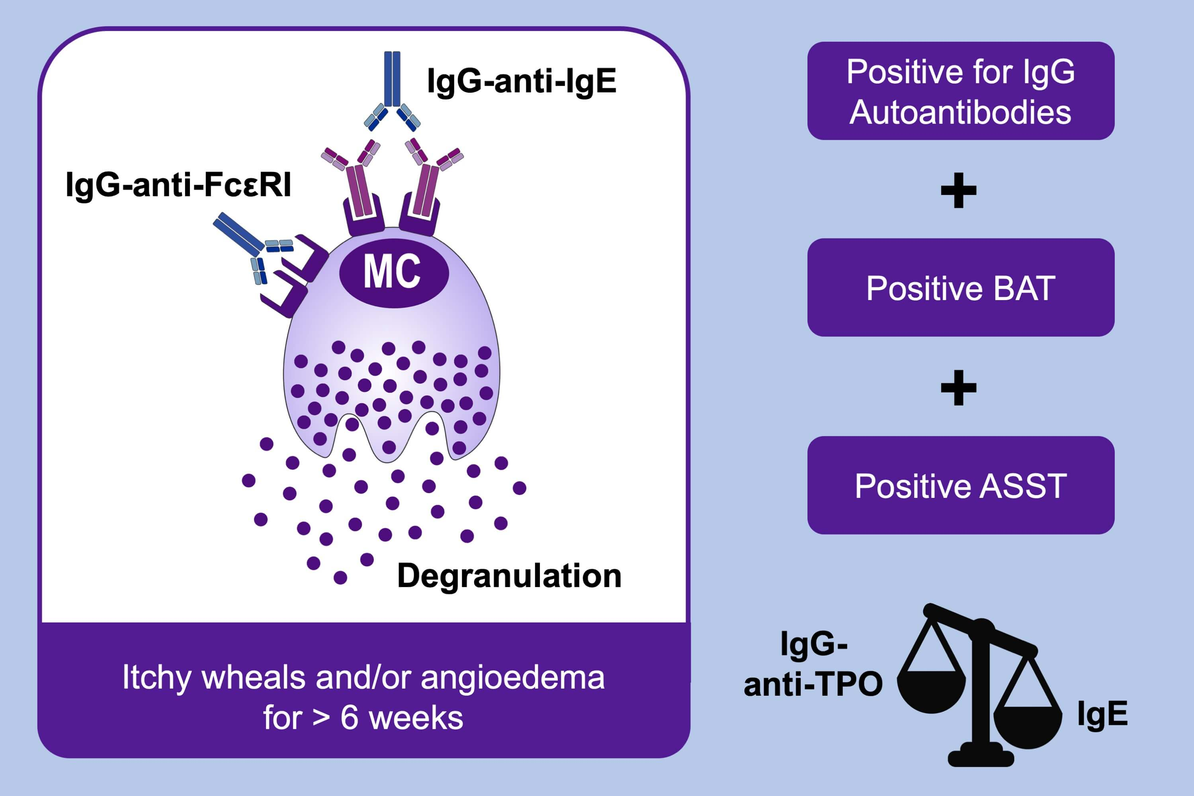
Biomarkers and clinical characteristics of autoimmune chronic spontaneous urticaria: Results of the PURIST Study
Nicole Schoepke, Riccardo Asero, André Ellrich, Marta Ferrer, Ana Gimenez‐Arnau et al.
Allergy. 2019; 2427-2436 https://doi.org/10.1111/all.13949
© 2019 EAACI and John Wiley and Sons A/S. Published by John Wiley and Sons Ltd.
Notes:
HIGHLIGHTS
• Autoimmune chronic spontaneous urticaria (aiCSU) is defined by IgG anti‐IgE or FcεRI, a positive basophil activation test (BAT), and a positive autologous serum skin test (ASST).
• Fourteen percent of ASST+ patients have aiCSU with low IgE levels and elevated levels of anti‐thyroperoxidase.
• Positive BAT and basophil histamine release assays (BHRA) were 69% and 88% predictive of aiCSU and, therefore, are biomarkers.

