Slide 1
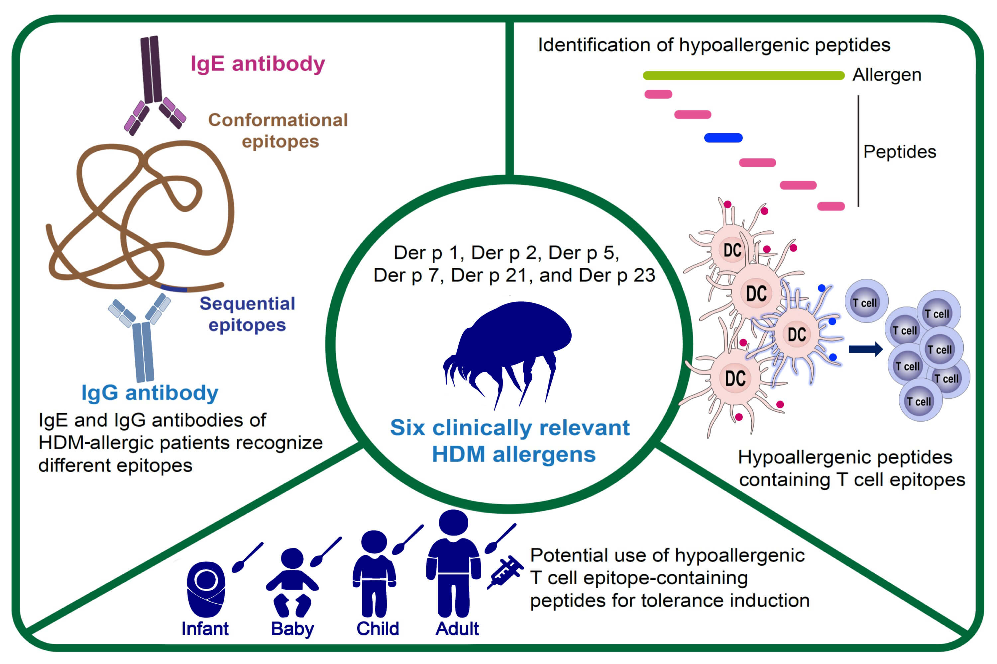
A hypoallergenic peptide mix containing T cell epitopes of the clinically relevant house dust mite allergens
Huey‐Jy Huang, Mirela Curin, Srinita Banerjee, Kuan‐Wei Chen, Tetiana Garmatiuk et al.
Allergy. 2019; 2461-2478 https://doi.org/10.1111/all.13956
© 2019 EAACI and John Wiley and Sons A/S. Published by John Wiley and Sons Ltd.
Notes:
HIGHLIGHTS
• A mix of thirty‐one hypoallergenic peptides containing T cell epitopes of the six most important house dust mite (HDM) allergens was identified.
• Natural IgG antibodies of HDM‐allergic patients recognize different epitopes than IgE antibodies.
• Hypoallergenic T cell epitope–containing peptides comprising the important HDM allergens may be used for therapy and prevention of HDM allergy.

