Slide 1
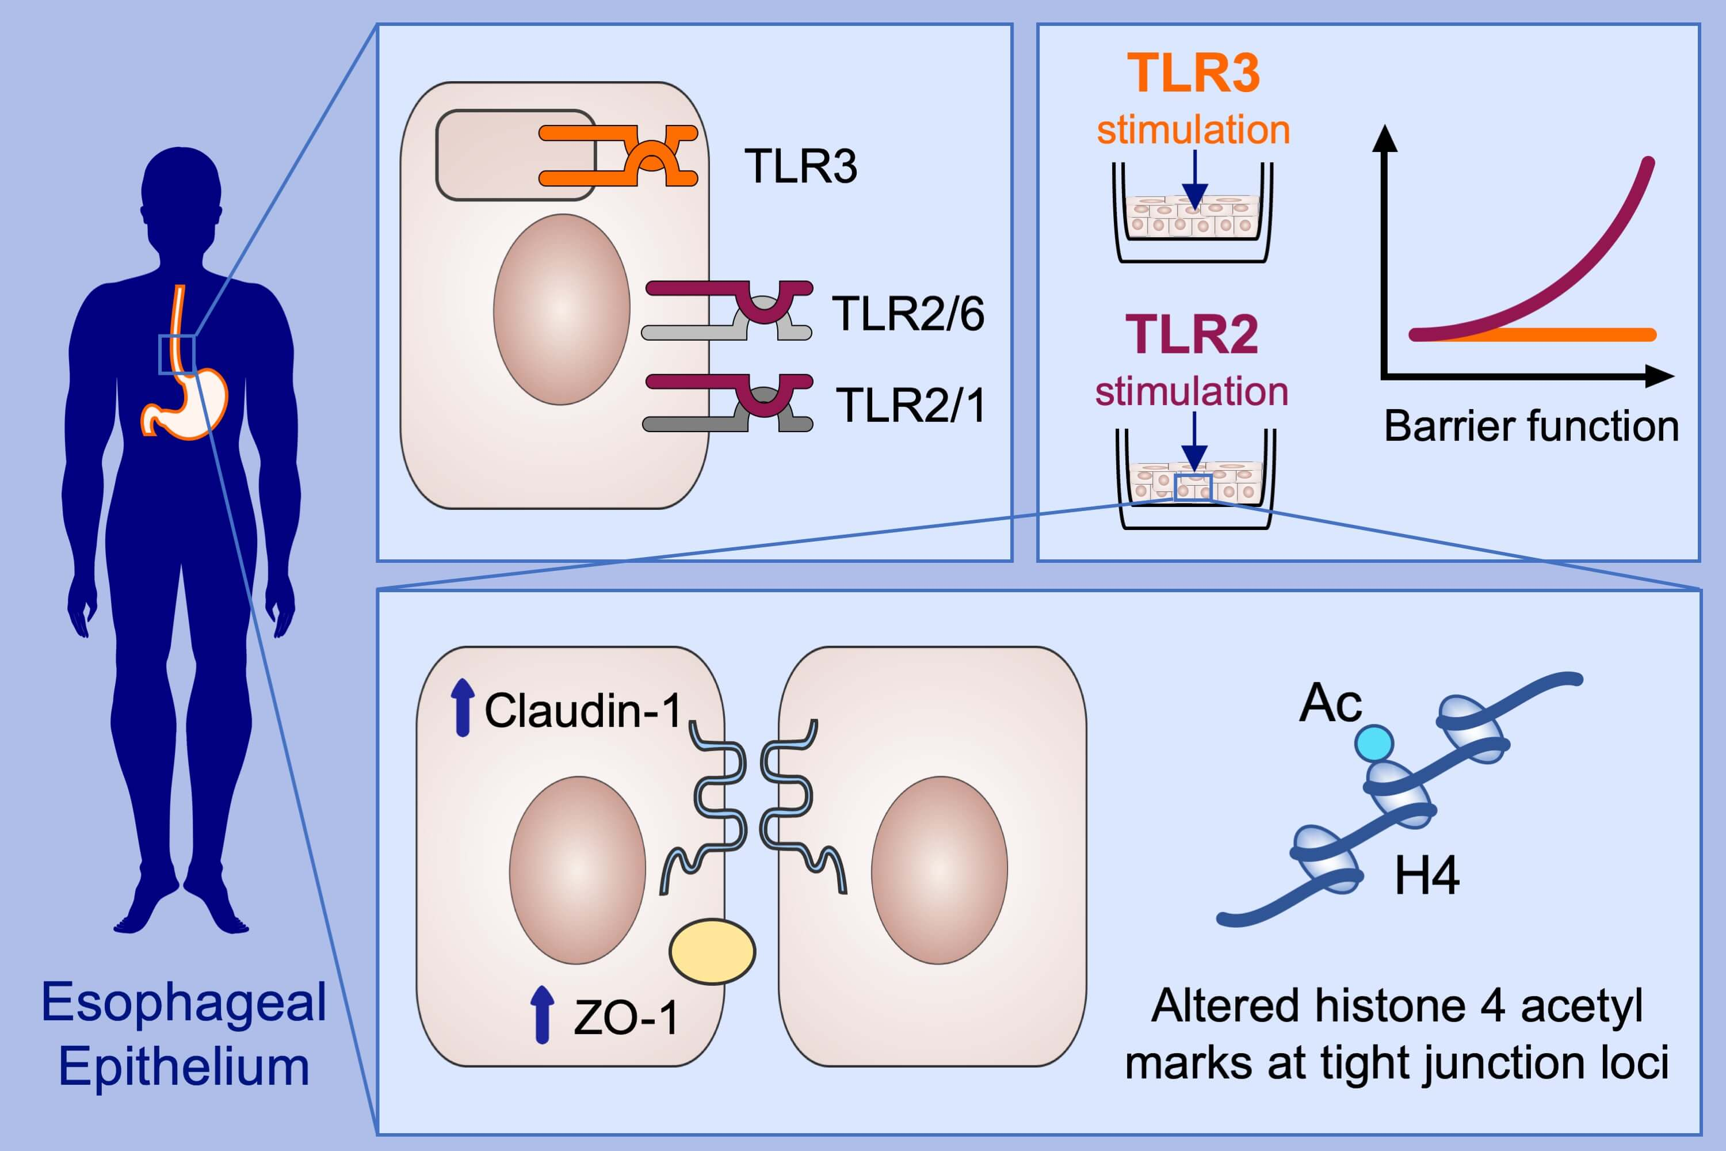
Toll‐like receptor 2 stimulation augments esophageal barrier integrity
Melanie A. Ruffner, Li Song, Kelly Maurer, Lihua Shi, Margaret C. Carroll et al.
Allergy. 2019; 2449-2460 https://doi.org/10.1111/all.13968
© 2019 EAACI and John Wiley and Sons A/S. Published by John Wiley and Sons Ltd.
Notes:
HIGHLIGHTS
• Our findings demonstrated robust expression of TLR2 and TLR3 in primary esophageal epithelial cells.
• We observed increased epithelial barrier function (increased transepithelial electrical resistance, decreased paracellular flux) upon anti‐TLR2 stimulation of esophageal epithelium cultured under ALI, while anti‐TLR3 treatment had no effect.
• TLR2 stimulation upregulated expression of tight junction proteins and increased acetylation of histone 4 at the claudin‐1 gene enhancer and promoter.
ABBREVIATIONS
Ac, Acetylation; H4, Histone 4; TEER, Transepithelial electrical resistance;TLR, Toll like receptor; ZO-1, zonula occludens-1

