Slide 1
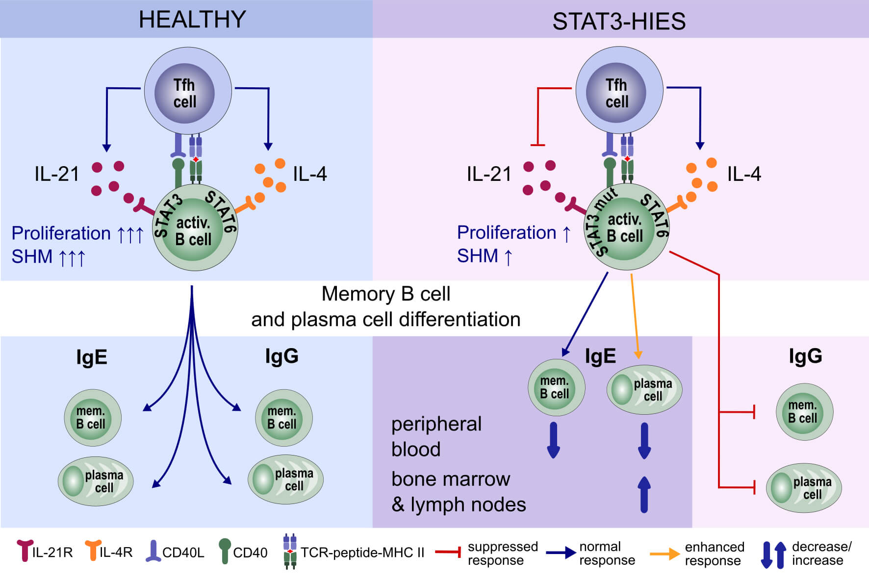
Impaired memory B‐cell development and antibody maturation with a skewing toward IgE in patients with STAT3 hyper‐IgE syndrome
Willem van de Veen, Carolin E. Krätz, Craig I. McKenzie, Pei M. Aui, Jens Neumann et al.
Allergy. 2019; 2394-2405 https://doi.org/10.1111/all.13969
© 2019 EAACI and John Wiley and Sons A/S. Published by John Wiley and Sons Ltd.
Notes:
HIGHLIGHTS
• STAT3‐HIES patients have reduced plasmablast and memory B cell frequencies, while showing normal IgE+ B‐cell frequencies.
• Despite normal lymph node GC architecture, STAT3‐HIES B cells show reduced proliferation in response to IL‐21 and reduced IGHV SHM levels.
• Relatively large numbers of IgE+ plasma cells were detected in STAT3‐HIES patients' bone marrow and lymph node tissue.
ABBREVIATIONS
GC, Germinal Center; HIES, hyper IgE syndrome; IGHV, immunoglobulin heavy chain variable region gene; SHM, somatic hypermutation;
STAT3, signal transducer and activator of transcription 3

